Slide 1

Using Hystrix to Build Resilient Distributed Systems
Matt Jacobs
Netflix

Slide 2
Who am I?
Edge Platform team at Netflix
In a 24/7 Support Role for Netflix production
(Not 365/24/7)
Maintainer of Hystrix OSS
github.com/Netflix/Hystrix
I get a lot of internal questions too

Slide 3

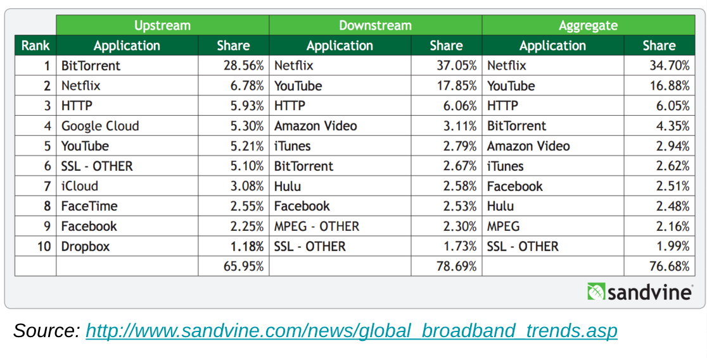
Video on Demand
1000s of device types
1000s of microservices
Control Plane completely on AWS
Competing against products which have high availability (network / cable TV)

Slide 4



2013 – now
from 40M to 75M+ paying customers
from 40 to 190+ countries (#netflixeverywhere)
In original programming, from House of Cards to hundreds of hours a year, in documentaries / movies / comedy specials/ TV series

Slide 5
Edge Platform @ Netflix
Goal: Maximize availability of Netflix API
API used by all customer devices

Slide 6
Edge Platform @ Netflix
Goal: Maximize availability of Netflix API
API used by all customer devices
How?
Fault-tolerant by design
Operational visibility
Limit manual intervention
Understand failure modes before they happen

Slide 7
Hystrix @ Netflix
Fault-tolerance pattern as a library
Provides operational insights in real-time
Automatic load-shedding under pressure
Initial design/implementation by Ben Christensen

Slide 8
Scope of this talk
User-facing request-response system that uses
blocking I/O
NOT batch system
NOT nonblocking I/O
(Hystrix can be used in those, though…)

Slide 9
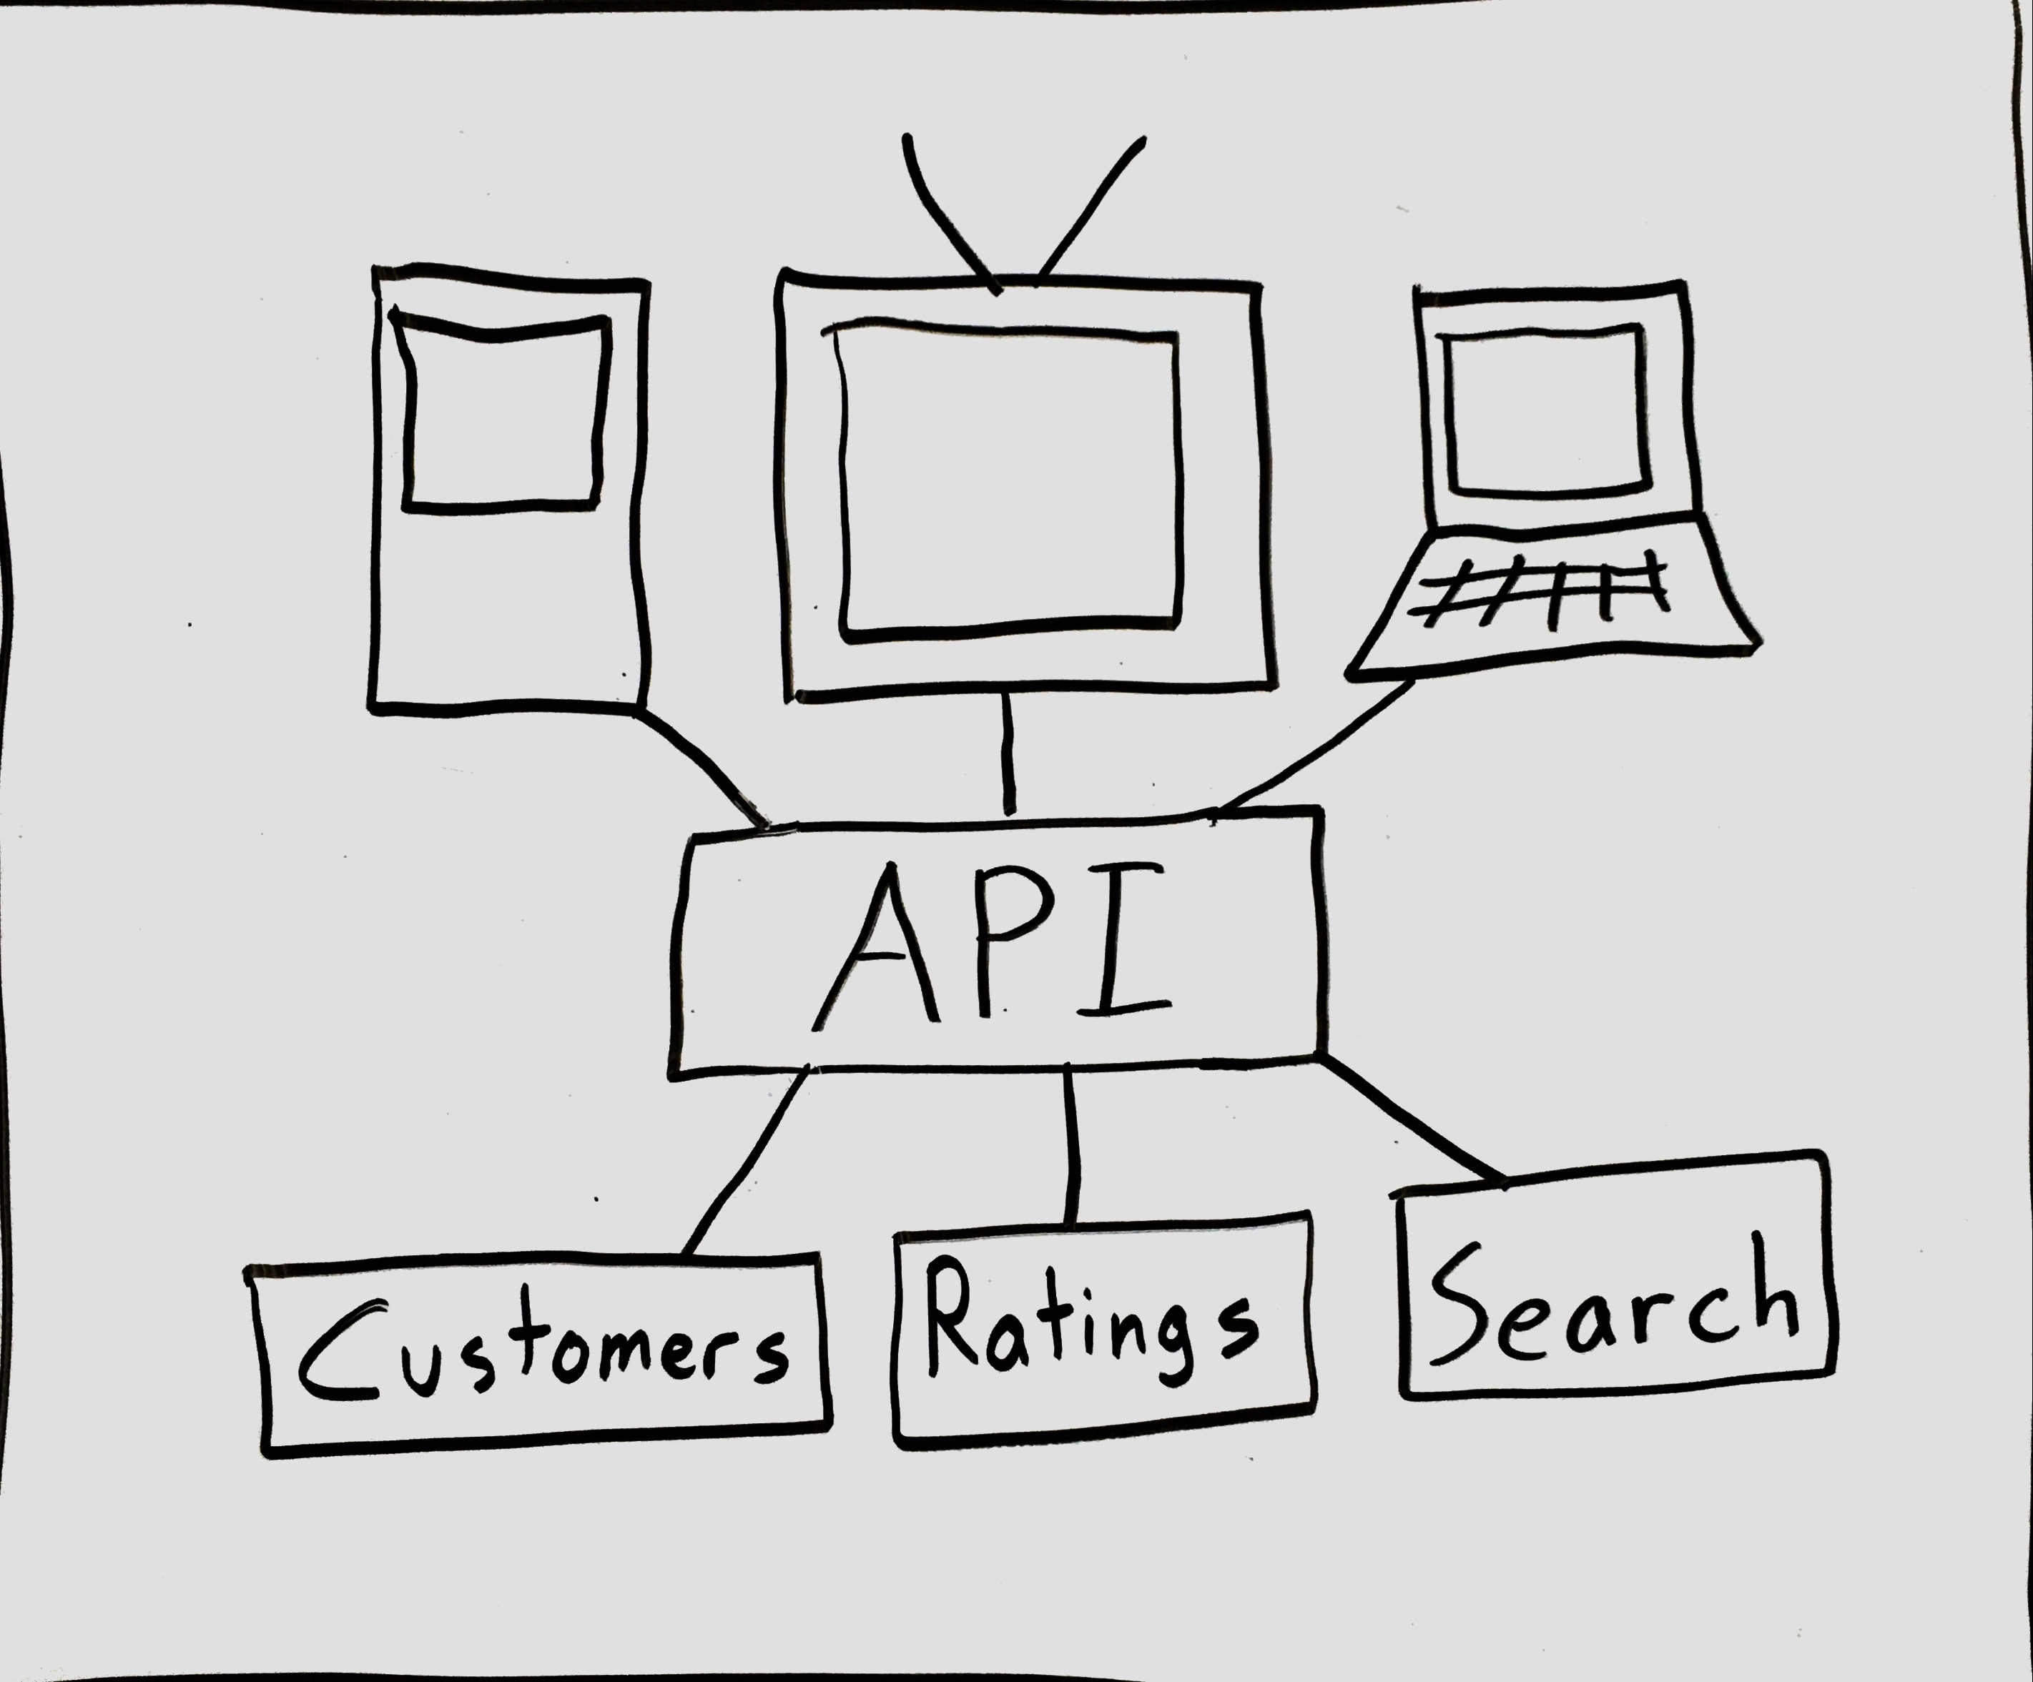
Netflix API

Slide 10
Goals of this talk
Philosophical Motivation
Why are distributed systems hard?
Practical Motivation
Why do I keep getting paged?
Solving those problems with Hystrix
How does it work?
How do I use it in my system?
How should a system behave if I use Hystrix?
What? Netflix was down for me – what happened there?

Slide 11
Goals of this talk
Philosophical Motivation
Why are distributed systems hard?
Practical Motivation
Why do I keep getting paged?
Solving those problems with Hystrix
How does it work?
How do I use it in my system?
How should a system behave if I use Hystrix?
What? Netflix was down for me – what happened there?

Slide 12
Un-Distributed Systems
Write an application and deploy!

Slide 13
Distributed Systems
Write an application and deploy!
Add a redundant system for resiliency (no SPOF)
Break out the state
Break out the function (microservices)
Add more machines to scale horizontally
Notes:
Add a callback to Simon’s keynote. Design for modularity within a monolith. I agree completely, but fundamentally remote is different from local.

Slide 14
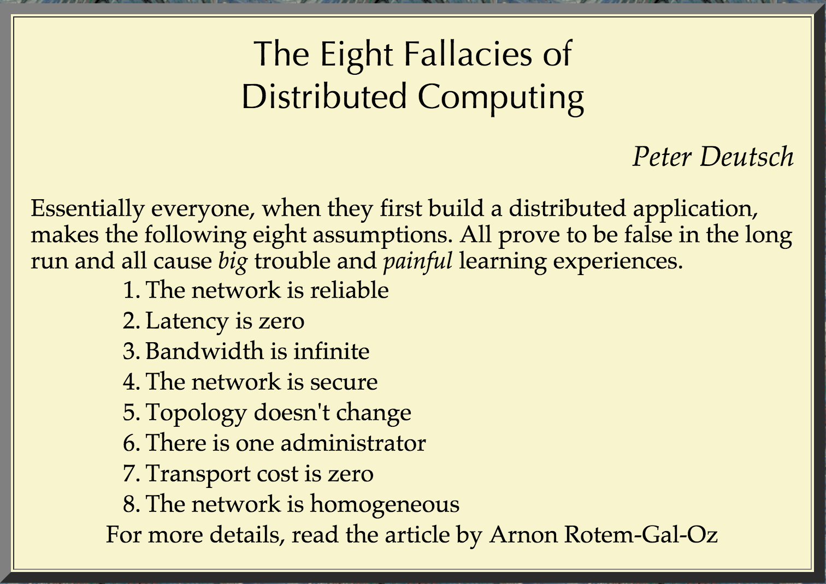
Source: https://blogs.oracle.com/jag/resource/Fallacies.html

Slide 15
Fallacies of Distributed Computing
Network is reliable
Latency is zero
Bandwidth is infinite
Network is secure
Topology doesn’t change
There is 1 administrator
Transport cost is 0
Network is homogenous

Slide 16
Fallacies of Distributed Computing
Network is reliable
Latency is zero
Bandwidth is infinite
Network is secure
Topology doesn’t change
There is 1 administrator
Transport cost is 0
Network is homogenous

Slide 17
Fallacies of Distributed Computing
In the cloud, other services are reliable
In the cloud, latency is zero
In the cloud, bandwidth is infinite
Network is secure
Topology doesn’t change
In the cloud, there is 1 administrator
Transport cost is 0
Network is homogenous

Slide 18
Other Services are Reliable
getCustomer() fails at 0% when on-box

Slide 19
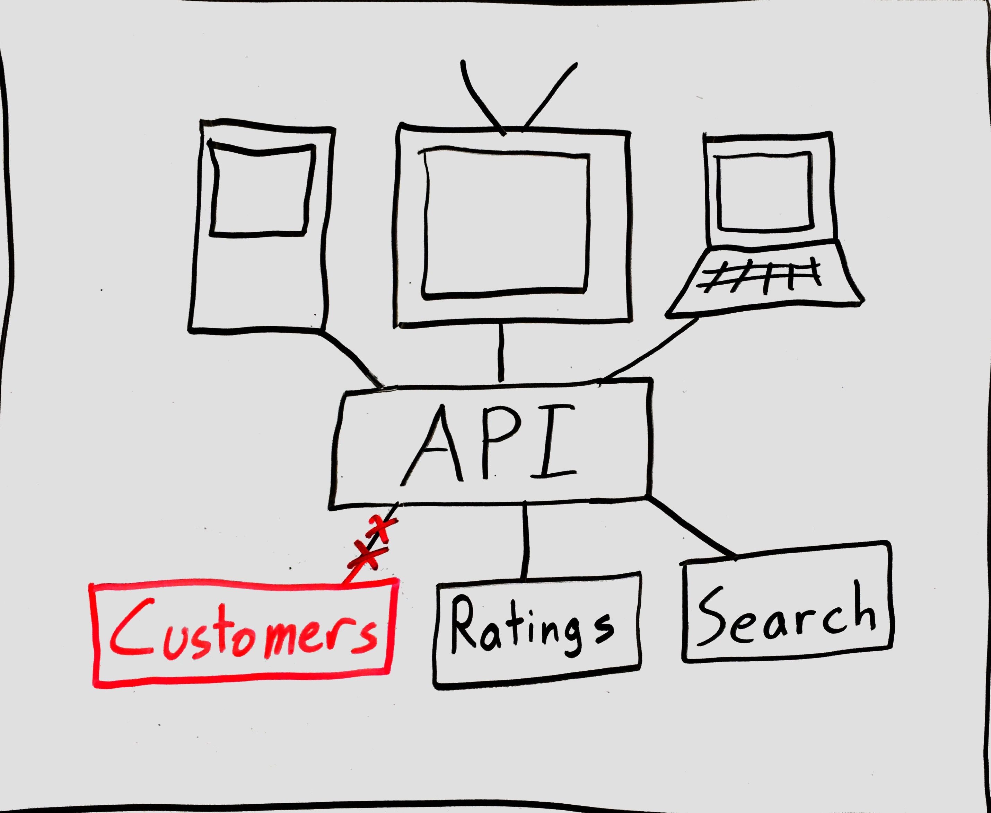
Other Services are Reliable
getCustomer() used to fail at 0%

Slide 20
Latency is zero
search(term) returns in μs or ns

Slide 21
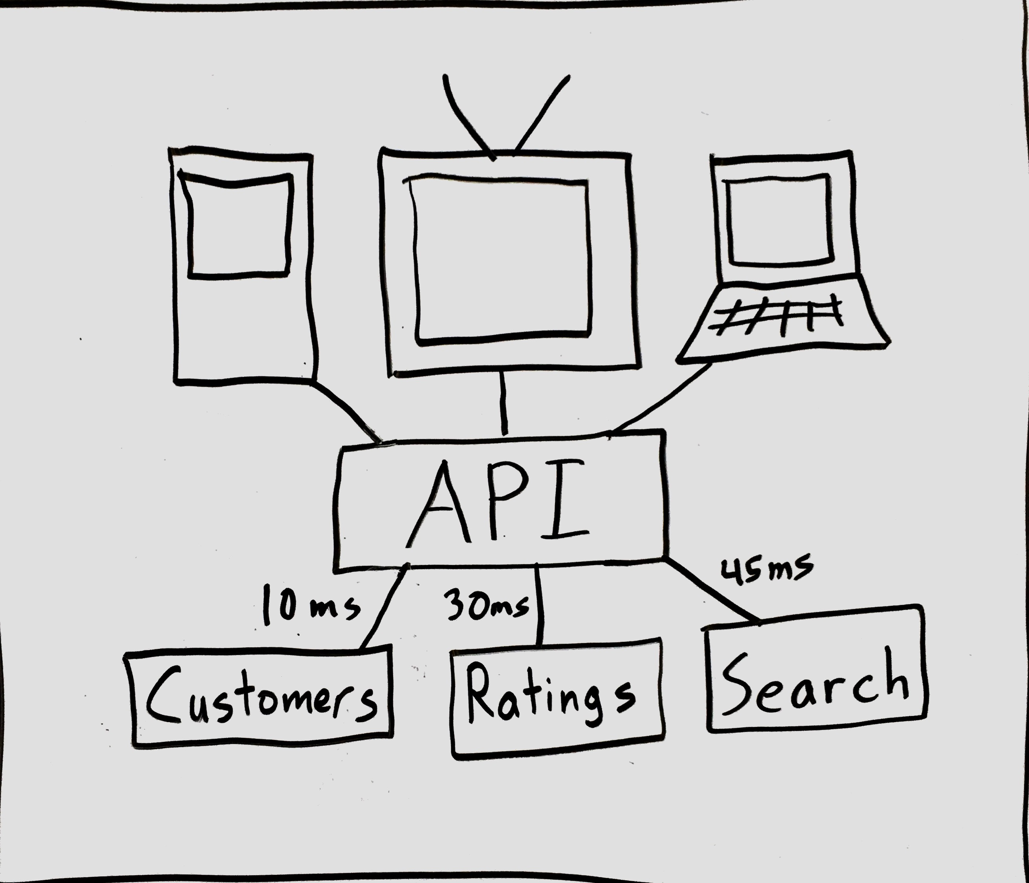
Latency is zero
search(term) used to return in μs or ns
Notes:
There is fundamentally more work being done here. Serialization / deserializion / system calls / whatever syscall does to your CPU caches / IO (bounded by speed of light)

Slide 22
Bandwidth is infinite
Making n calls to getRating() is fine

Slide 23
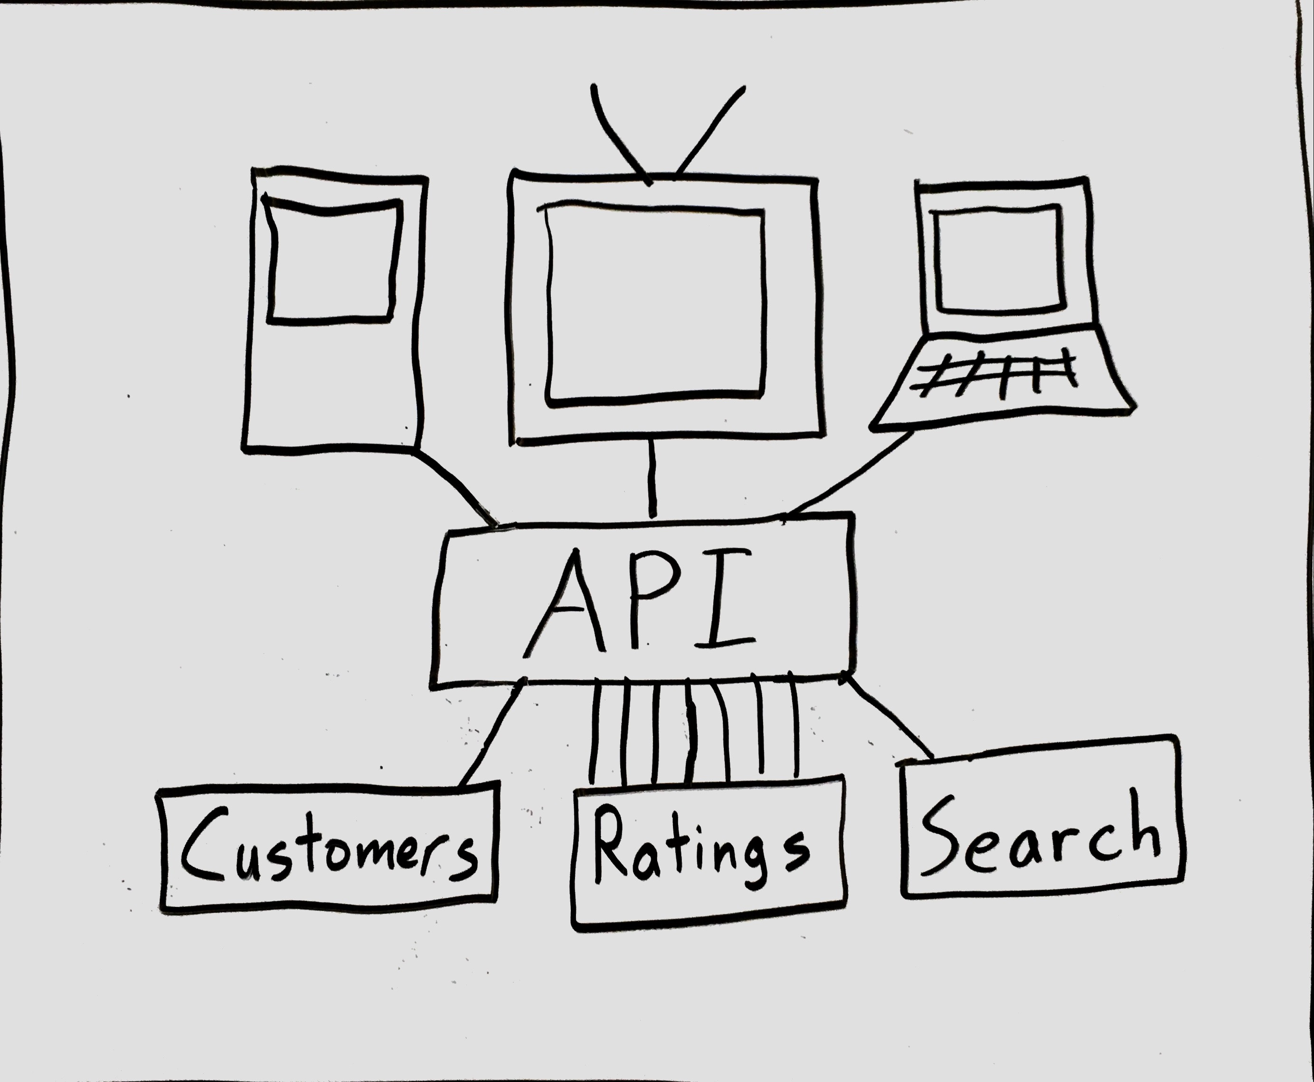
Bandwidth is infinite
Making n calls to getRating() results in multiple network calls

Slide 24
There is 1 administrator
Deployments are in 1 person’s head

Slide 25

There is 1 administrator
Deployments are distributed

Slide 26
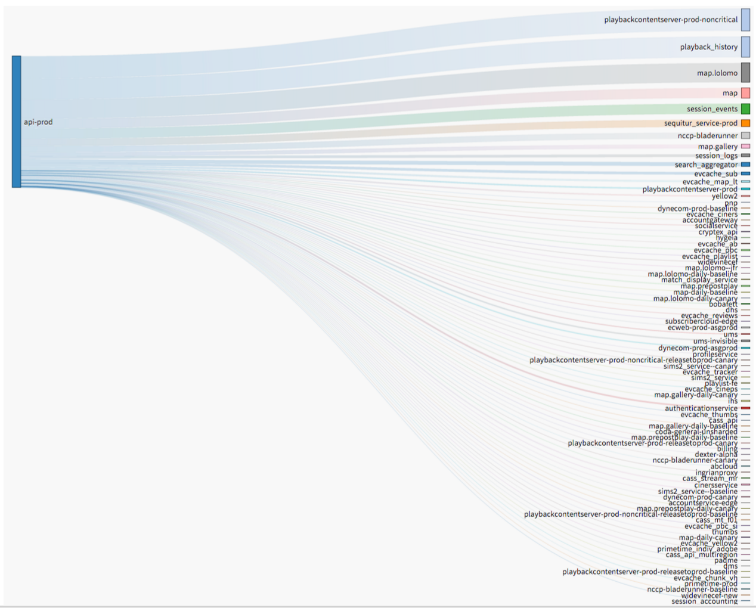
There is 1 administrator

Slide 27
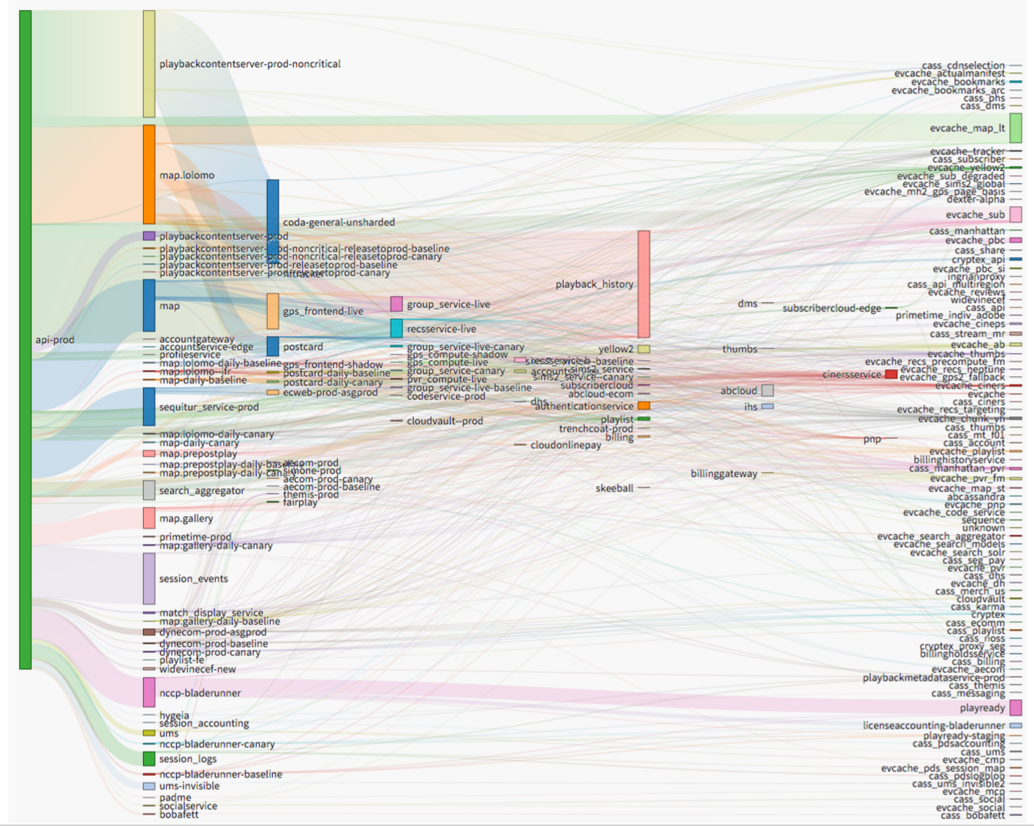
There is 1 administrator

Slide 28
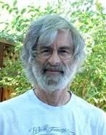
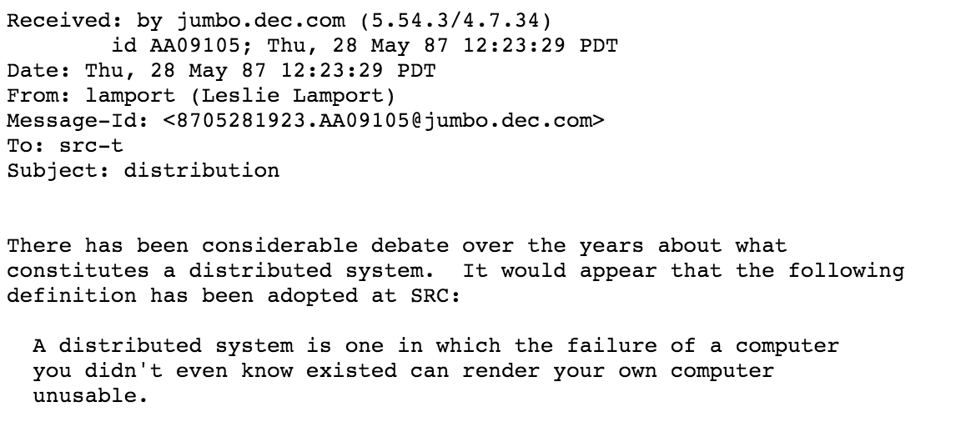
There is 1 administrator
Source: http://research.microsoft.com/en-us/um/people/lamport/pubs/distributed-system.txt

Slide 29
Goals of this talk
Philosophical Motivation
Why are distributed systems hard?
Practical Motivation
Why do I keep getting paged?
Solving those problems with Hystrix
How does it work?
How do I use it in my system?
How should a system behave if I use Hystrix?
What? Netflix was down for me – what happened there?

Slide 30
Operating a Distributed System
How can I stop going to incident reviews?
Which occur every time we cause customer pain

Slide 31
Operating a Distributed System
How can I stop going to incident reviews?
Which occur every time we cause customer pain
We must assume every other system can fail

Slide 32
Operating a Distributed System
How can I stop going to incident reviews?
Which occur every time we cause customer pain
We must assume every other system can fail
We must understand those failure modes and prevent them from cascading

Slide 33
Operating a Distributed System (bad)

Slide 34
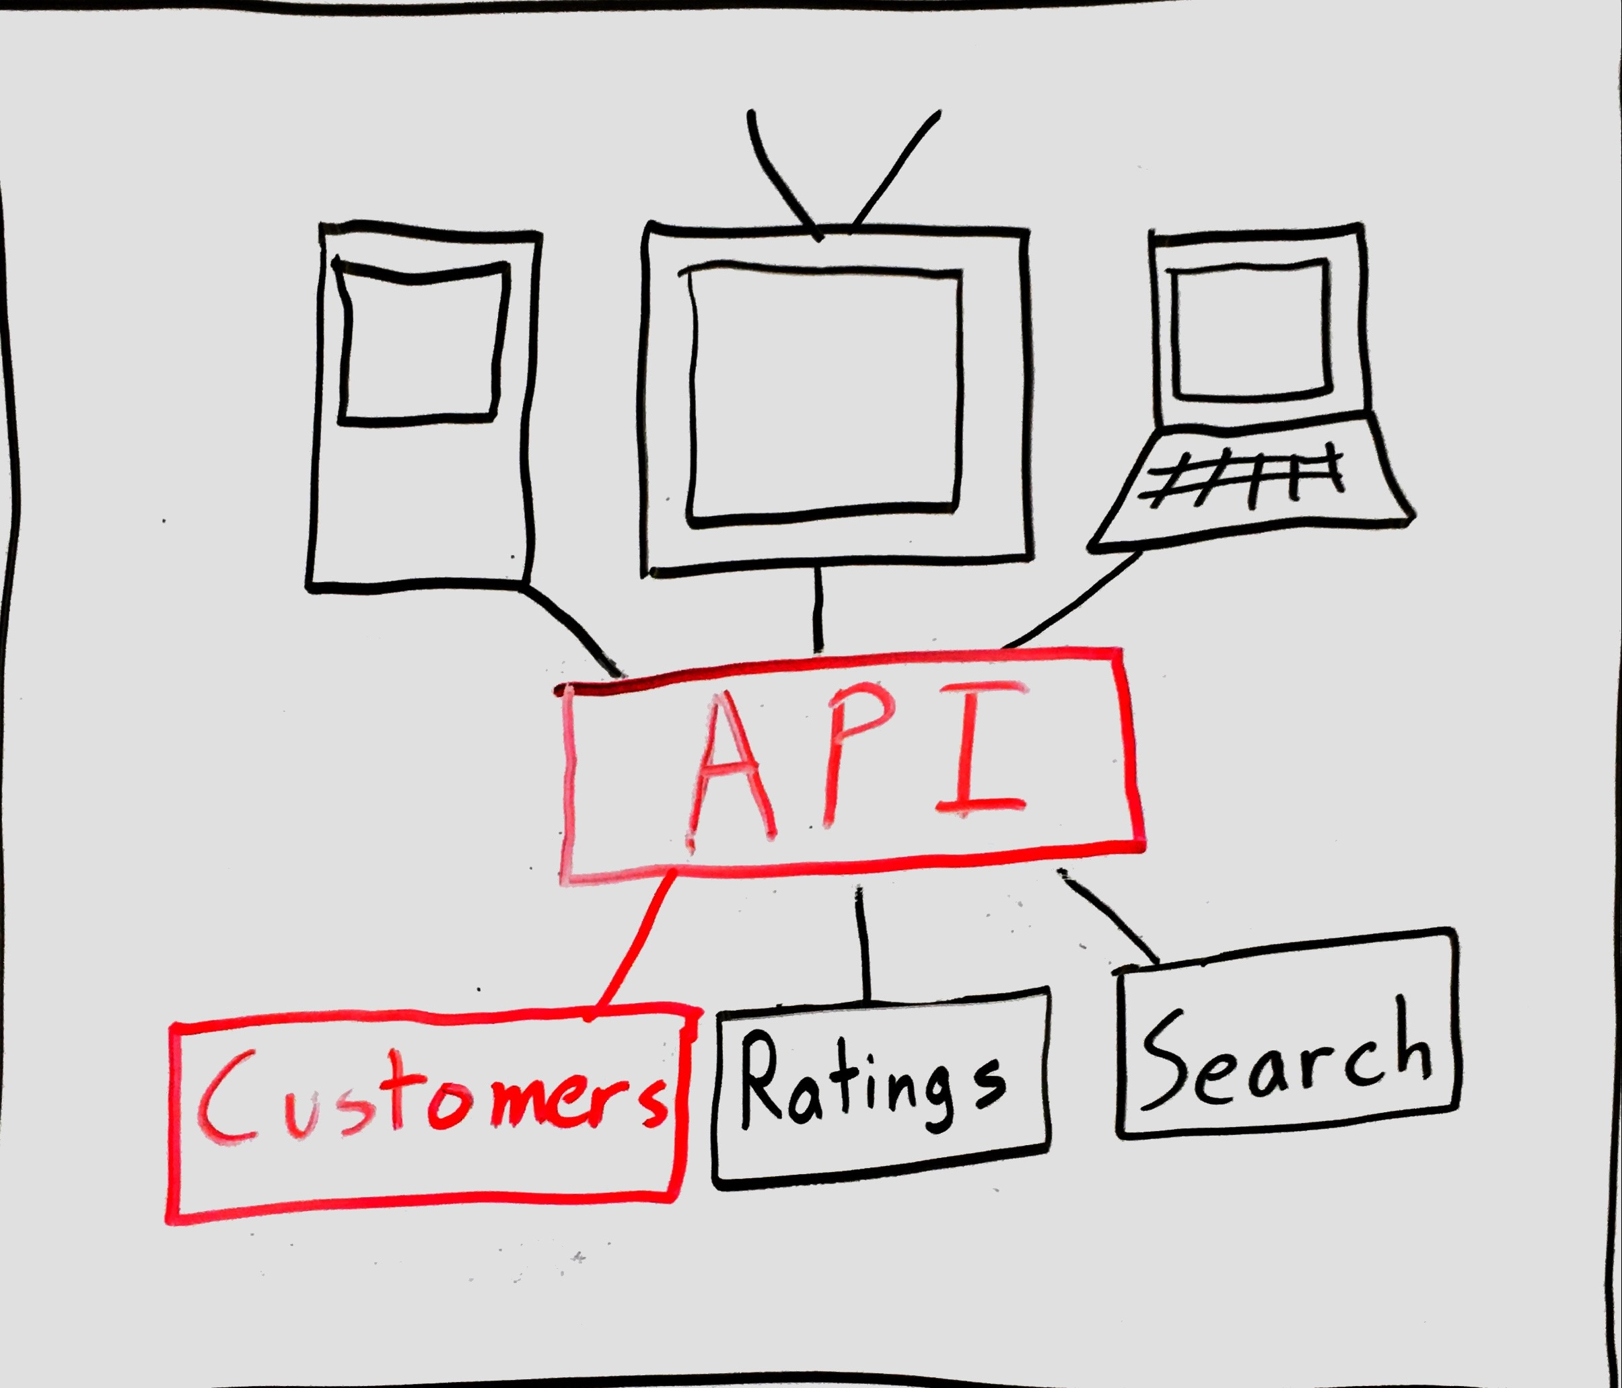
Operating a Distributed System (bad)

Slide 35
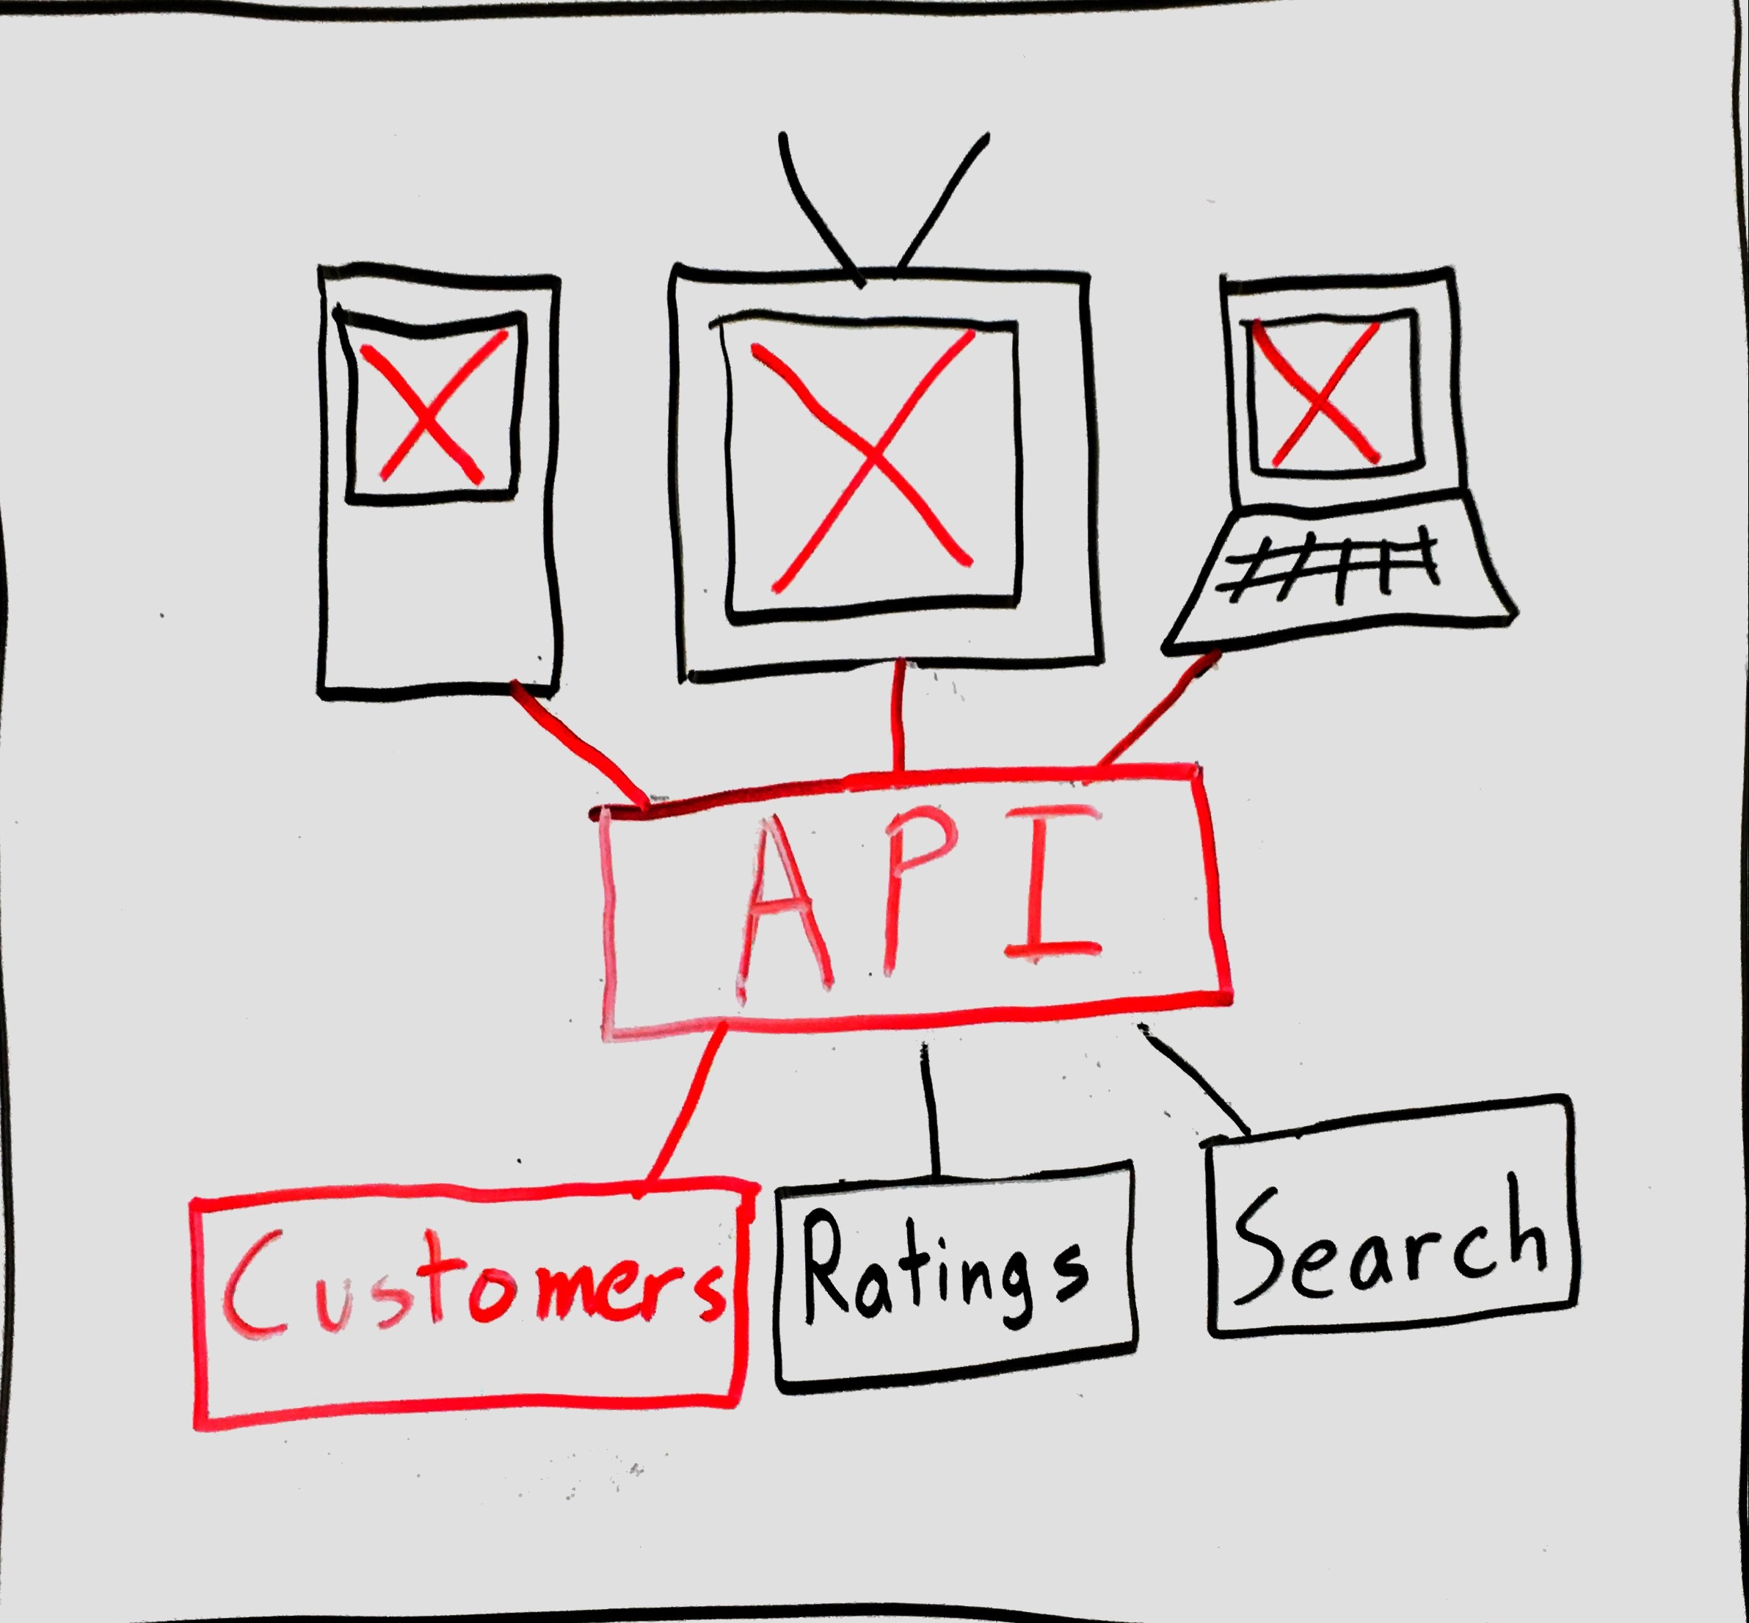
Operating a Distributed System (bad)

Slide 36
Operating a Distributed System (good)

Slide 37
Failure Modes (in the small)
Errors
Latency

Slide 38
If you don’t plan for errors

Slide 39
How to handle Errors
return getCustomer(id);

Slide 40
How to handle Errors
try { return getCustomer(id); } catch (Exception ex) { //TODO What to return here? }

Slide 41
How to handle Errors
try { return getCustomer(id); } catch (Exception ex) { //static value return null; }

Slide 42
How to handle Errors
try { return getCustomer(id); } catch (Exception ex) { //value from memory return anonymousCustomer; }

Slide 43
How to handle Errors
try { return getCustomer(id); } catch (Exception ex) { //value from cache return cache.getCustomer(id); }

Slide 44
How to handle Errors
try { return getCustomer(id); } catch (Exception ex) { //value from service return customerViaSecondSvc(id); }

Slide 45
How to handle Errors
try { return getCustomer(id); } catch (Exception ex) { //explicitly rethrow throw ex; }

Slide 46
Handle Errors with Fallbacks
Some options for fallbacks
Static value
Value from in-memory
Value from cache
Value from network
Throw
Make error-handling explicit
Applications have to work in the presence of either fallbacks or rethrown exceptions

Slide 47
Handle Errors with Fallbacks

Slide 48
Exposure to failures
As your app grows, your set of dependencies is much more likely to get bigger, not smaller
Overall uptime = (Dep uptime)^(num deps)
Dependency uptime
 | 99.99% | 99.9% | 99%
5 | 99.95% | 99.5% | 95%
10 | 99.9% | 99% | 90.4%
25 | 99.75% | 97.5% | 77.8%
Dependencies

Slide 49
If you don’t plan for Latency
First-order effect: outbound latency increase
Second-order effect: increase resource usage

Slide 50
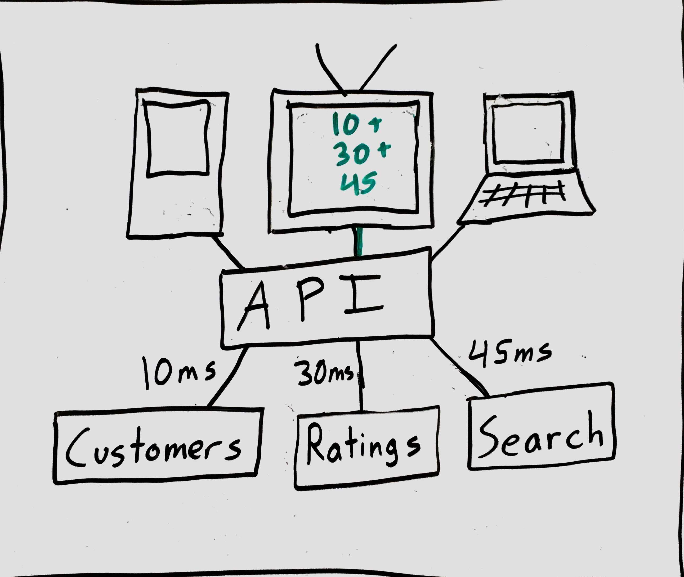
If you don’t plan for Latency
First-order effect: outbound latency increase

Slide 51
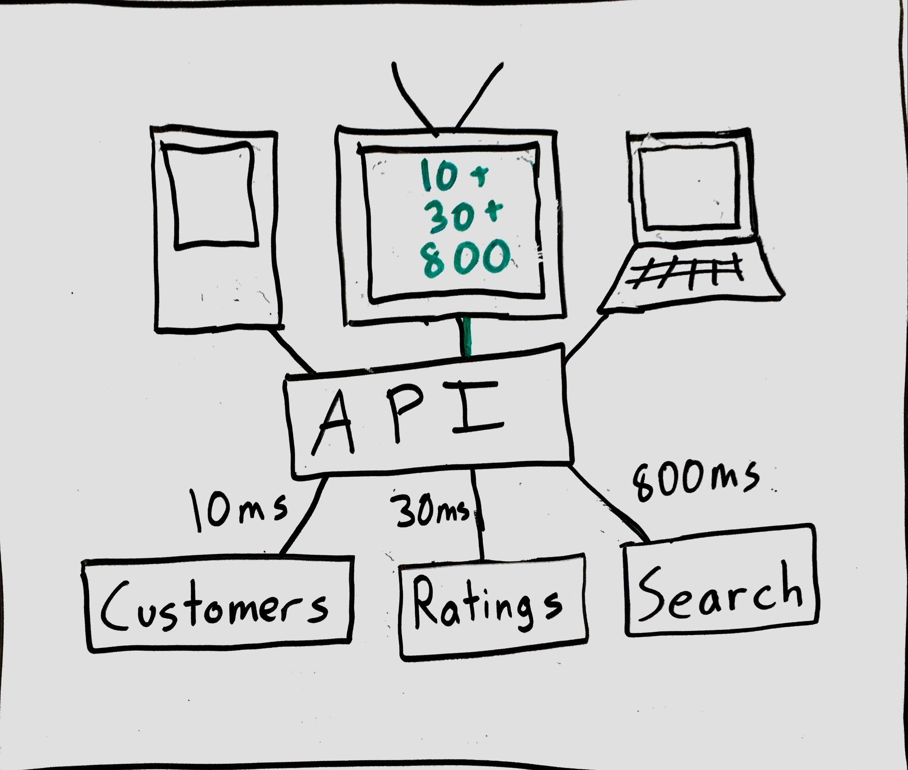
If you don’t plan for Latency
First-order effect: outbound latency increase

Slide 52
Queuing theory
Say that your application is making 100RPS of a network call and mean latency is 10ms

Slide 53
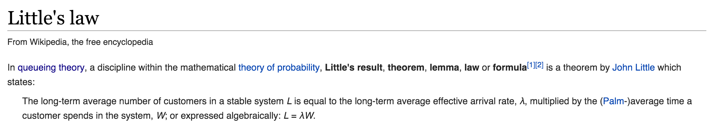
Queuing theory
Say that your application is making 100RPS of a network call and mean latency is 10ms
The utilization of I/O threads has a distribution over time – according to Little’s Law, the mean is 100 RPS * (1/100 s) = 1

Slide 54
Queuing theory
Say that your application is making 100RPS of a network call and mean latency is 10ms
The utilization of I/O threads has a distribution over time – according to Little’s Law, the mean is 100 RPS * (1/100 s) = 1
If mean latency increased to 100ms, mean utilization increases to 10

Slide 55
Queuing theory
Say that your application is making 100RPS of a network call and mean latency is 10ms
The utilization of I/O threads has a distribution over time – according to Little’s Law, the mean is 100 RPS * (1/100 s) = 1
If mean latency increased to 100ms, mean utilization increases to 10
If mean latency increased to 1000ms, mean utilization increases to 100

Slide 56
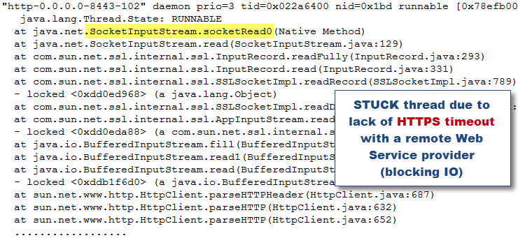
If you don’t plan for Latency

Slide 57
Handle Latency with Timeouts
Bound the worst-case latency

Slide 58
Handle Latency with Timeouts
Bound the worst-case latency
What should we return upon timeout?
We’ve already designed a fallback

Slide 59
Bound resource utilization
Don’t take on too much work globally

Slide 60
Bound resource utilization
Don’t take on too much work globally
Don’t let any single dependency take too many resources

Slide 61
Bound resource utilization
Don’t take on too much work globally
Don’t let any single dependency take too many resources
Bound the concurrency of each dependency

Slide 62
Bound resource utilization
Don’t take on too much work globally
Don’t let any single dependency take too many resources
Bound the concurrency of each dependency
What should we do if we’re at that threshold?
We’ve already designed a fallback.

Slide 63
Goals of this talk
Philosophical Motivation
Why are distributed systems hard?
Practical Motivation
Why do I keep getting paged?
Solving those problems with Hystrix
How does it work?
How do I use it in my system?
How should a system behave if I use Hystrix?
What? Netflix was down for me – what happened there?

Slide 64
Hystrix Goals
Handle Errors with Fallbacks
Handle Latency with Timeouts
Bound Resource Utilization

Slide 65
Handle Errors with Fallback
We need something to execute
We need a fallback

Slide 66
Handle Errors with Fallback
class CustLookup extends HystrixCommand<Customer> { @Override public Customer run() { return svc.getOverHttp(customerId); } }

Slide 67
Handle Errors with Fallback
class CustLookup extends HystrixCommand<Customer> { @Override public Customer run() { return svc.getOverHttp(customerId); } @Override public Customer getFallback() { return Customer.anonymousCustomer(); } }

Slide 68
Handle Errors with Fallback
class CustLookup extends HystrixCommand<Customer> { private final CustomersService svc; private final long customerId; public CustLookup(CustomersService svc, long id)
{ this.svc = svc; this.customerId = id; } //run() : has references to svc and customerId //getFallback() }

Slide 69
Handle Latency with Timeouts
We need a timeout value
And a timeout mechanism

Slide 70
Handle Latency with Timeouts
class CustLookup extends HystrixCommand<Customer> { private final CustomersService svc; private final long customerId; public CustLookup(CustomersService svc, long id)
{ super(timeout = 100); this.svc = svc; this.customerId = id; } //run(): has references to svc and customerId //getFallback() }

Slide 71
Handle Latency with Timeouts
What if run() does not respect your timeout?

Slide 72
Handle Latency with Timeouts
class CustLookup extends HystrixCommand<Customer> { @Override public Customer run() { return svc.getOverHttp(customerId); } @Override public Customer getFallback() { return Customer.anonymousCustomer(); } }

Slide 73
Handle Latency with Timeouts
class CustLookup extends HystrixCommand<Customer> { @Override public Customer run() { return svc.nowThisThreadIsMine(customerId); } @Override public Customer getFallback() { return Customer.anonymousCustomer(); } }

Slide 74
Handle Latency with Timeouts
What if run() does not respect your timeout?
We can’t control the I/O library
We can put it on a different thread to control its impact

Slide 75
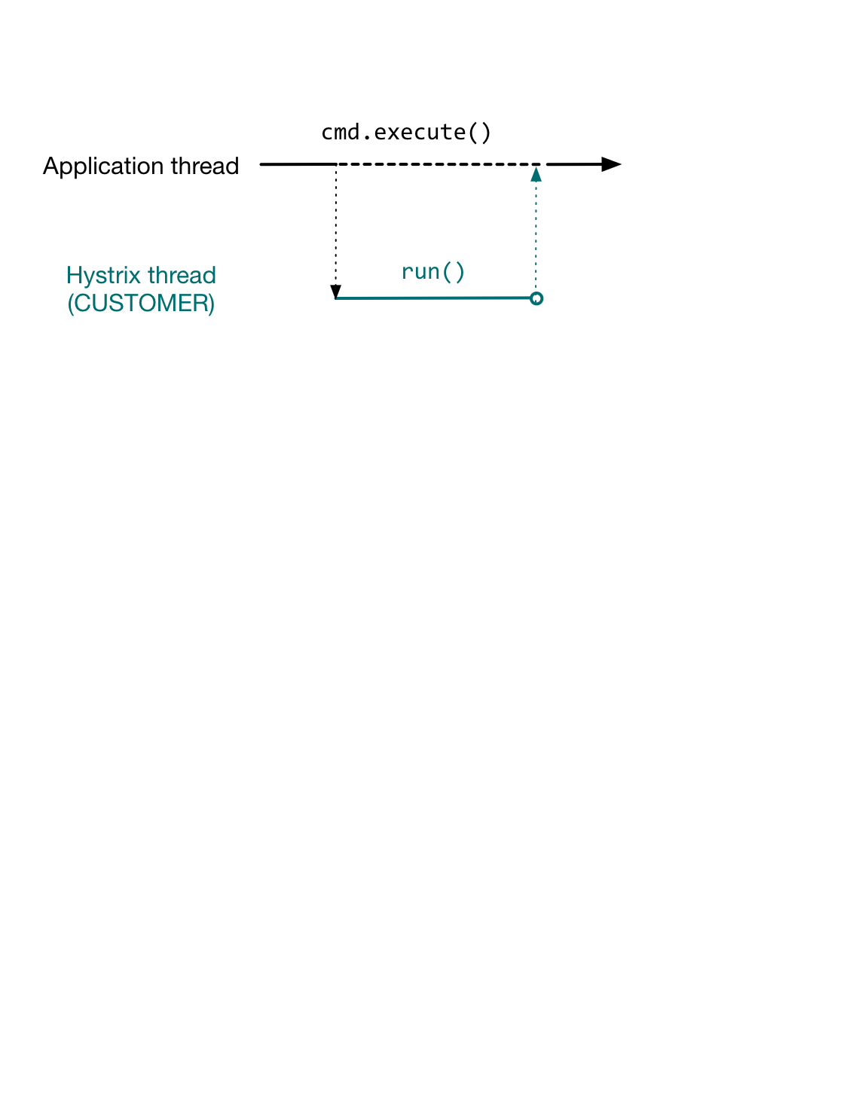
Hystrix execution model

Slide 76
Bound Resource Utilization
Since we’re using separate thread pool, we should give it a fixed size

Slide 77
Bound Resource Utilization
class CustLookup extends HystrixCommand<Customer> {
public CustLookup(CustomersService svc, long id)
{ super(timeout = 100, threadPool = “CUSTOMER”, threadPoolSize = 8); this.svc = svc; this.customerId = id; } //run() : has references to svc and customerId //getFallback() }

Slide 78
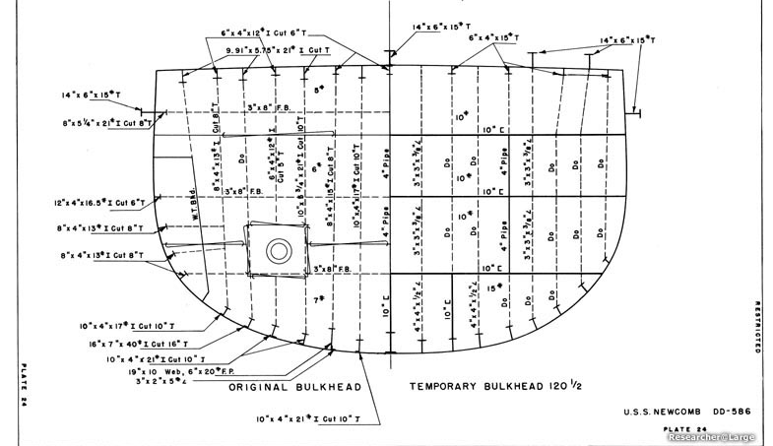
Thread pool as a bulkhead
Image Credit: http://www.researcheratlarge.com/Ships/DD586/DD586ForwardRepair.html

Slide 79
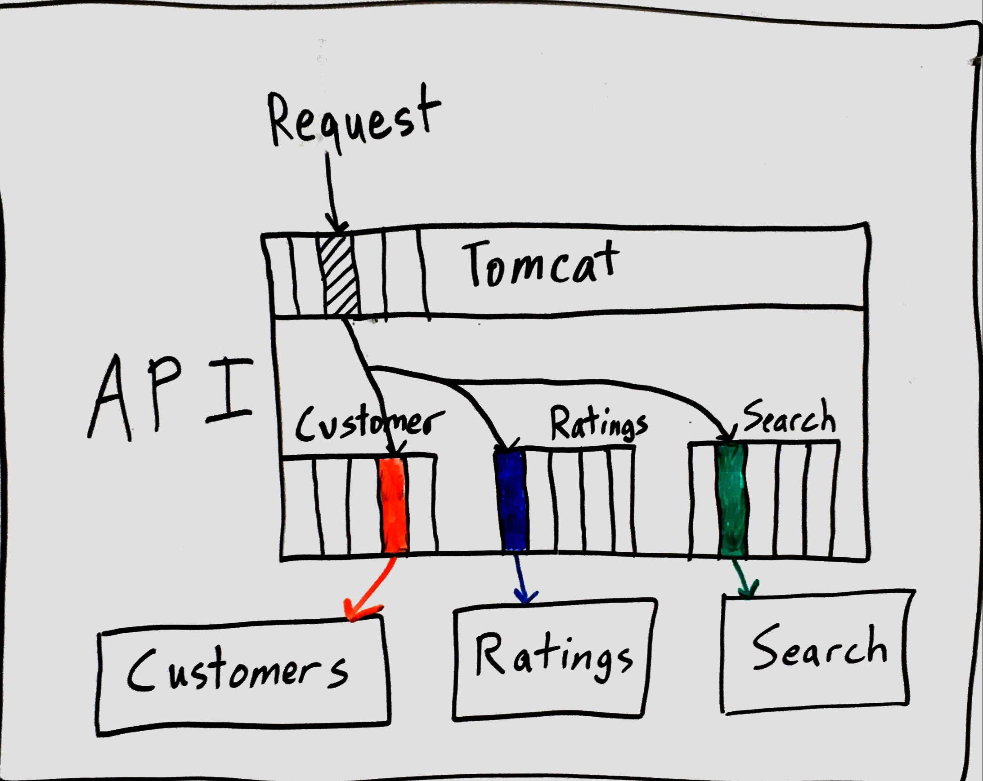
Thread pool as a bulkhead

Slide 80
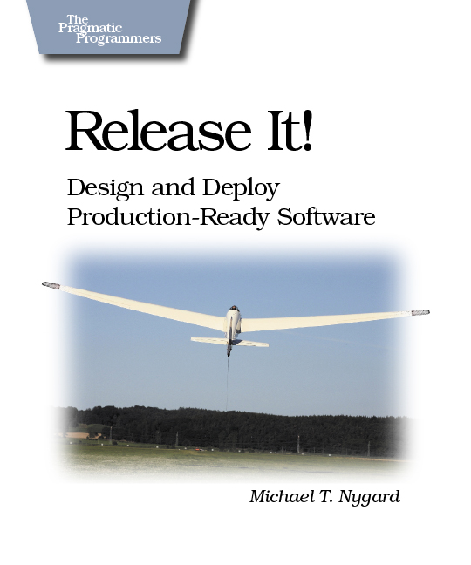
Circuit-Breaker
Popularized by Michael Nygard in “Release It!”

Slide 81
Circuit-Breaker
We can build feedback loop

Slide 82
Circuit-Breaker
We can build feedback loop
If command has high error rate in last 10 seconds, it’s more likely to fail right now

Slide 83
Circuit-Breaker
We can build feedback loop
If command has high error rate in last 10 seconds, it’s more likely to fail right now
Fail fast now – don’t spend my resources

Slide 84
Circuit-Breaker
We can build feedback loop
If command has high error rate in last 10 seconds, it’s more likely to fail right now
Fail fast now – don’t spend my resources
Give downstream system some breathing room

Slide 85
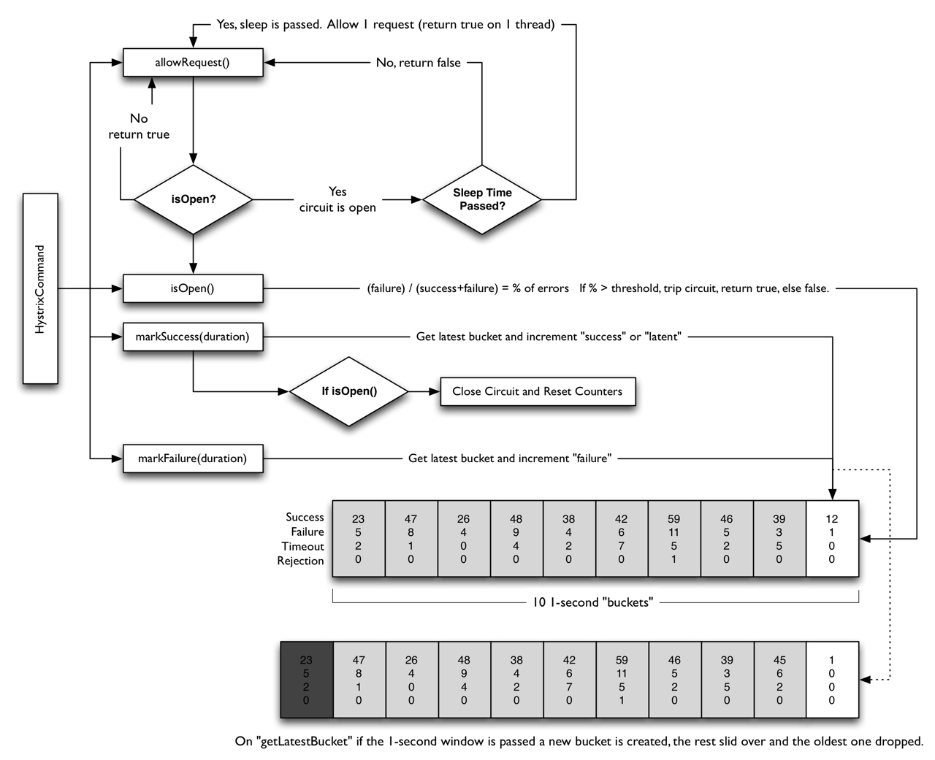

Slide 86
Hystrix as a Decision Tree
Compose all of the above behaviors

Slide 87
Hystrix as a Decision Tree
Compose all of the above behaviors
Now you’ve got a library!

Slide 88
SUCCESS
class CustLookup extends HystrixCommand<Customer> { @Override public Customer run() {
return svc.getOverHttp(customerId); //succeeds } @Override public Customer getFallback() { return Customer.anonymousCustomer(); } }

Slide 89
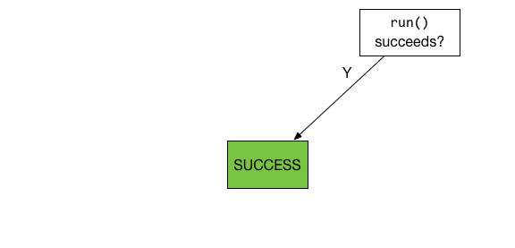
SUCCESS

Slide 90
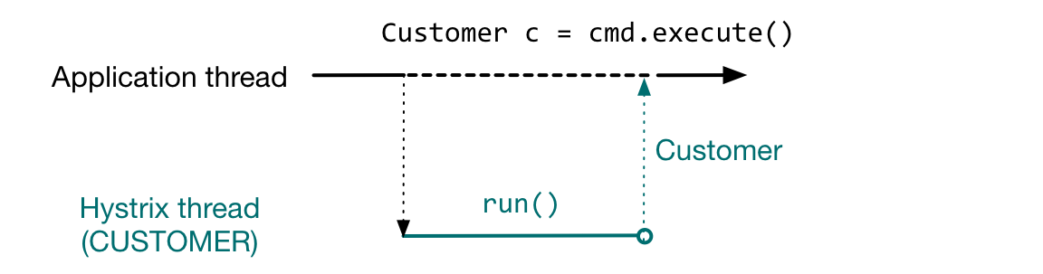
SUCCESS

Slide 91
FAILURE
class CustLookup extends HystrixCommand<Customer> { @Override public Customer run() { return svc.getOverHttp(customerId); //throws } @Override public Customer getFallback() { return Customer.anonymousCustomer(); } }

Slide 92
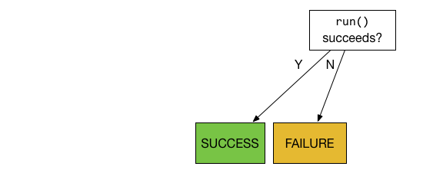
FAILURE

Slide 93
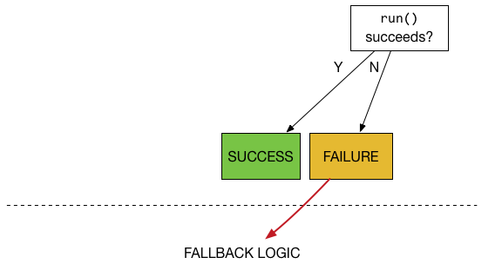
FAILURE

Slide 94
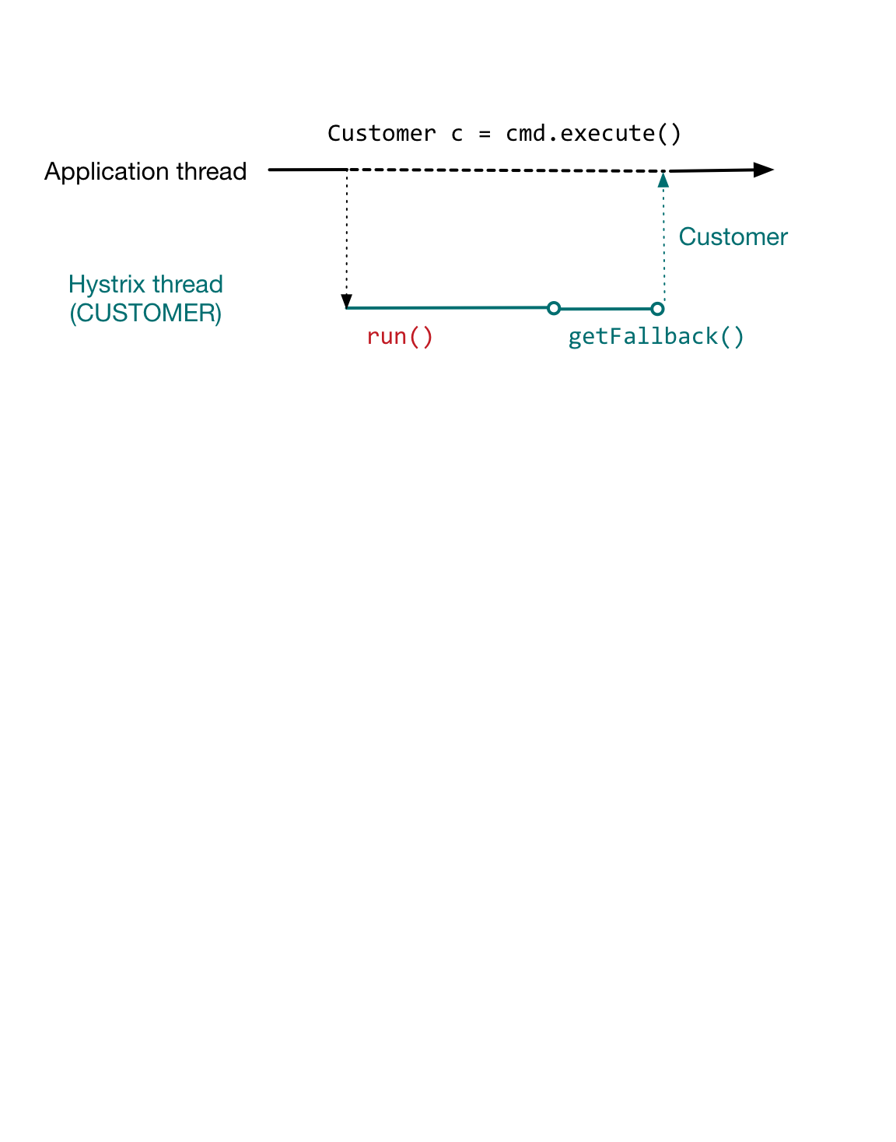
FAILURE

Slide 95
TIMEOUT
class CustLookup extends HystrixCommand<Customer> { @Override public Customer run() { //doesn’t return in time return svc.getOverHttp(customerId); } @Override public Customer getFallback() { return Customer.anonymousCustomer(); } }

Slide 96
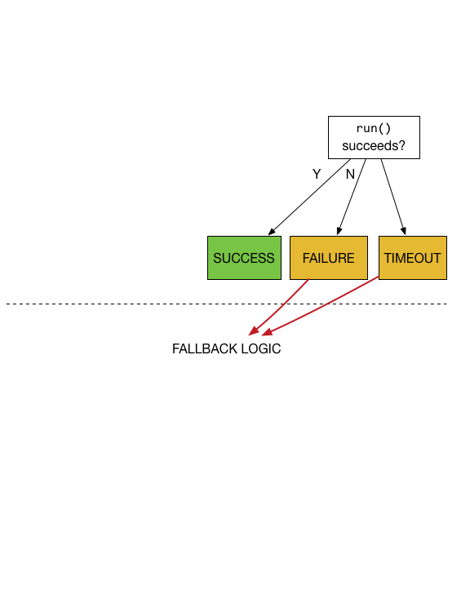
TIMEOUT

Slide 97
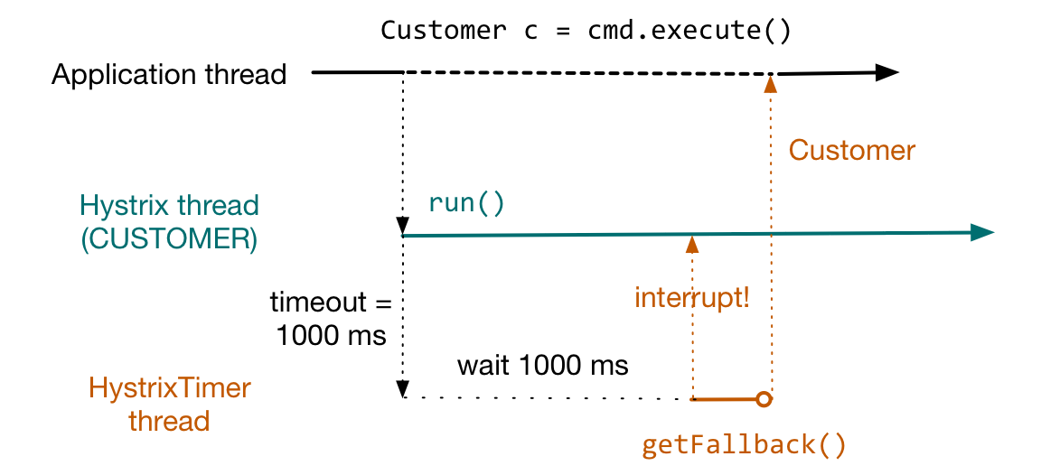
TIMEOUT

Slide 98
THREADPOOL-REJECTED
class CustLookup extends HystrixCommand<Customer> { @Override public Customer run() { //never runs – threadpool is full return svc.getOverHttp(customerId); } @Override public Customer getFallback() { return Customer.anonymousCustomer(); } }

Slide 99
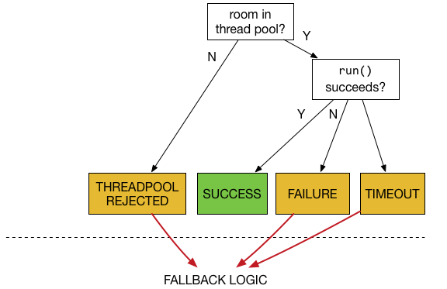
THREADPOOL-REJECTED

Slide 100
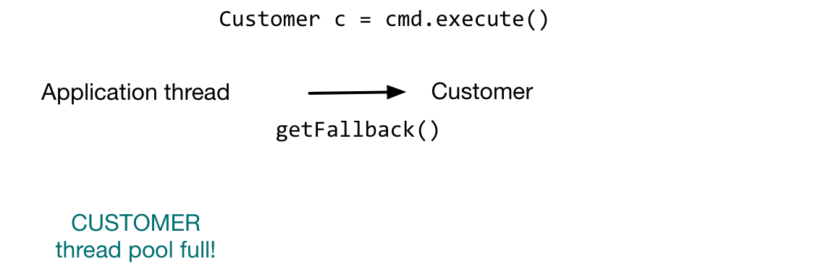
THREADPOOL-REJECTED

Slide 101
SHORT-CIRCUITED
class CustLookup extends HystrixCommand<Customer> { @Override public Customer run() { //never runs – circuit is open return svc.getOverHttp(customerId); } @Override public Customer getFallback() { return Customer.anonymousCustomer(); } }

Slide 102
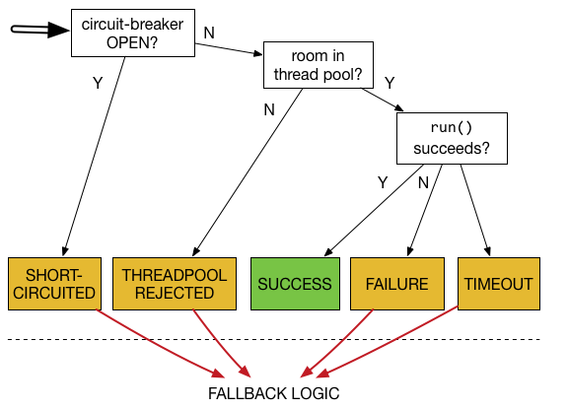
SHORT-CIRCUITED

Slide 103

SHORT-CIRCUITED

Slide 104
Fallback Handling
What are the basic error modes?
Failure
Latency

Slide 105
Fallback Handling
What are the basic error modes?
Failure
Latency
We need to be aware of failures in fallback
No automatic recovery provided – single fallback is enough

Slide 106
Fallback Handling
What are the basic error modes?
Failure
Latency
We need to be aware of failures in fallback
We need to protect ourselves from latency in fallback
Add a semaphore to fallback to bound concurrency

Slide 107
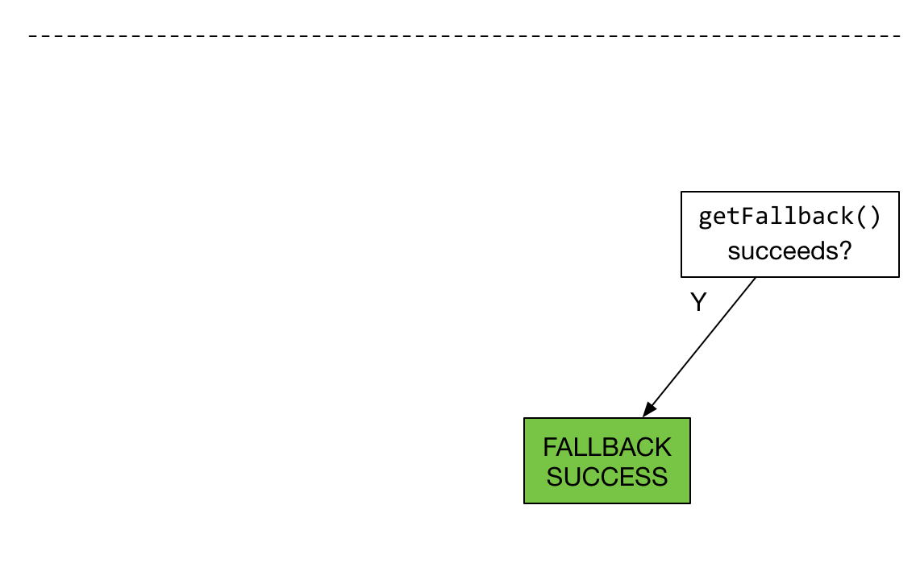
FALLBACK SUCCESS

Slide 108
FALLBACK SUCCESS

Slide 109
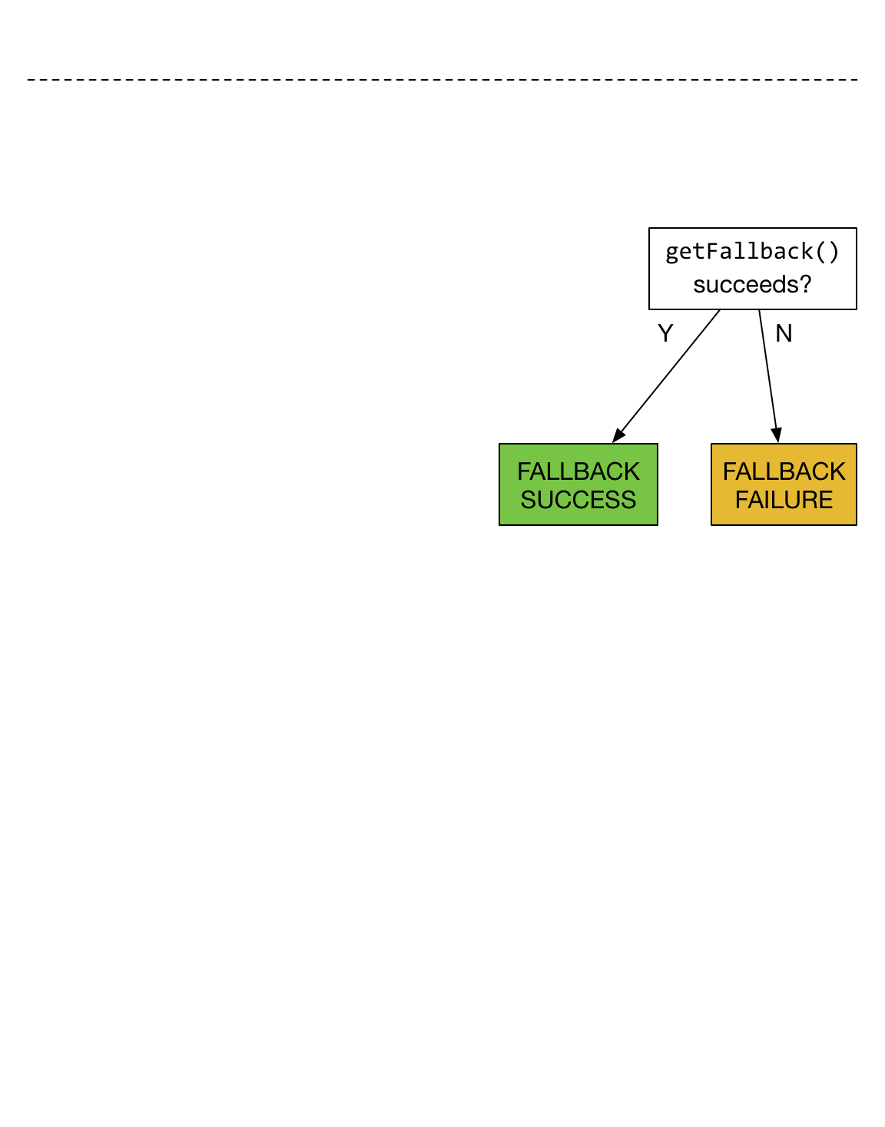
FALLBACK FAILURE

Slide 110
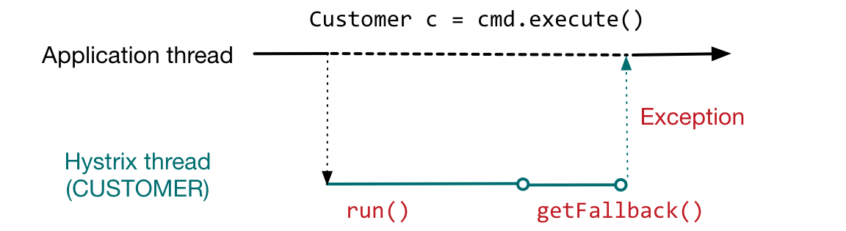
FALLBACK FAILURE

Slide 111
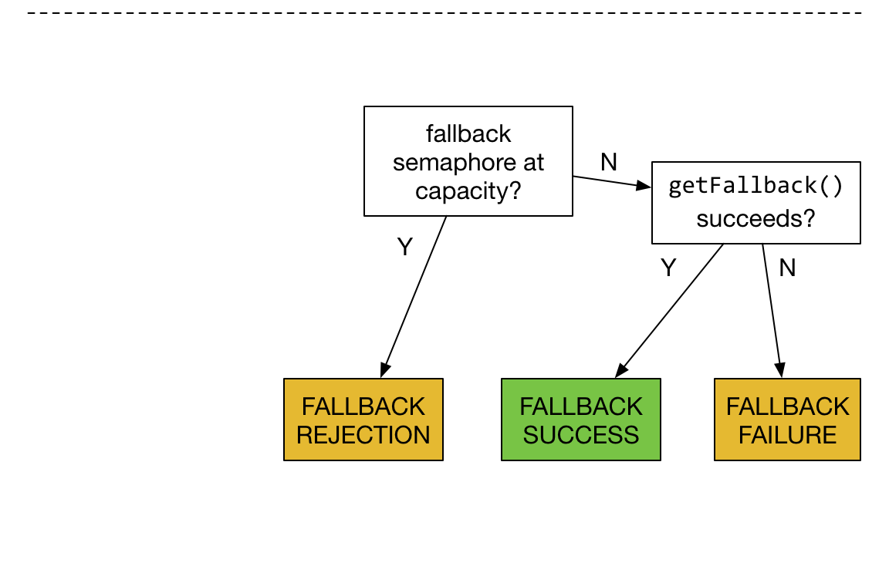
FALLBACK REJECTION

Slide 112
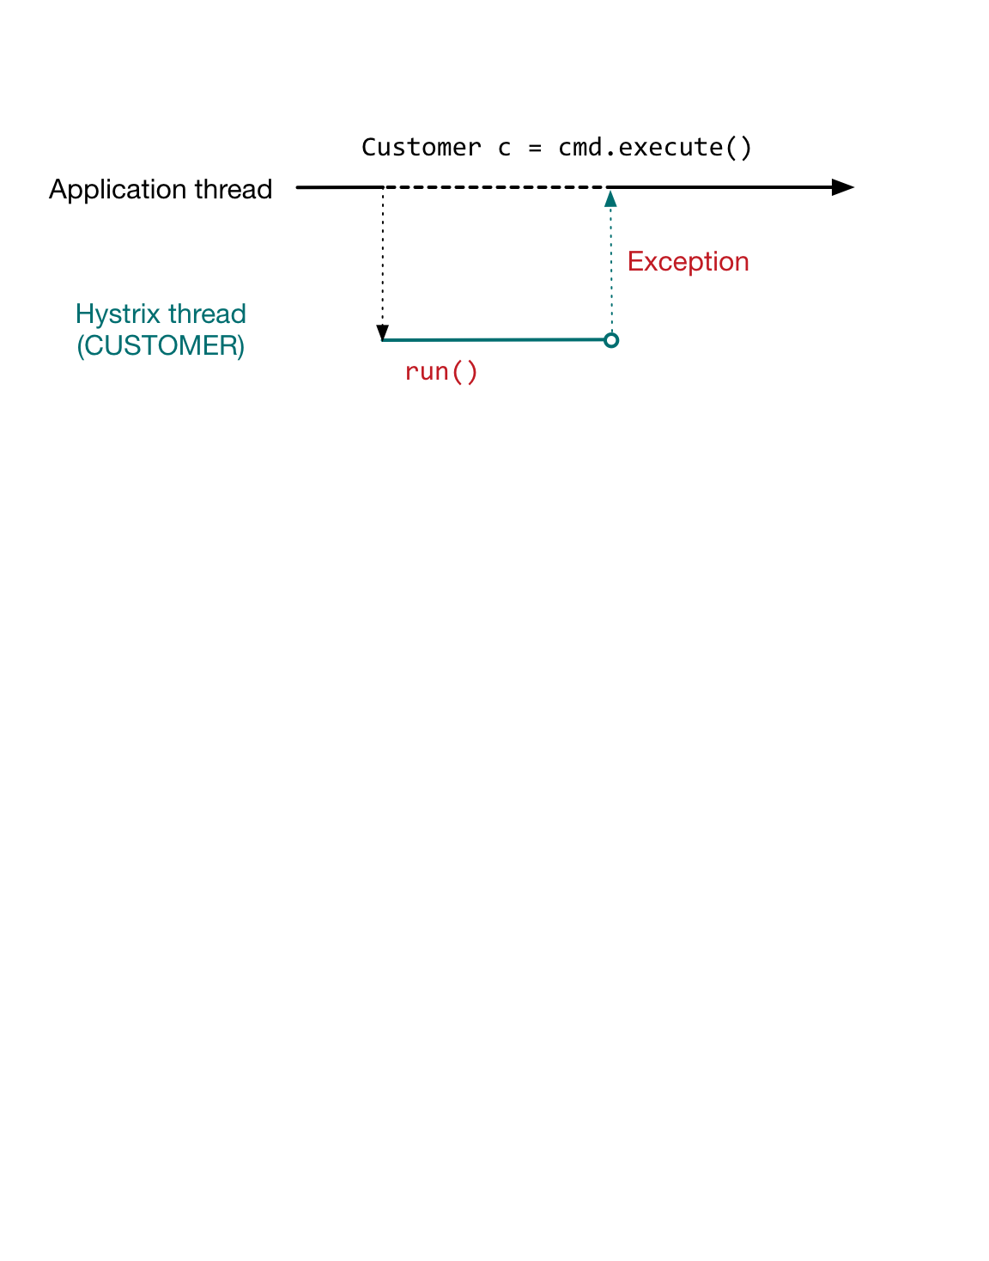
FALLBACK REJECTION

Slide 113
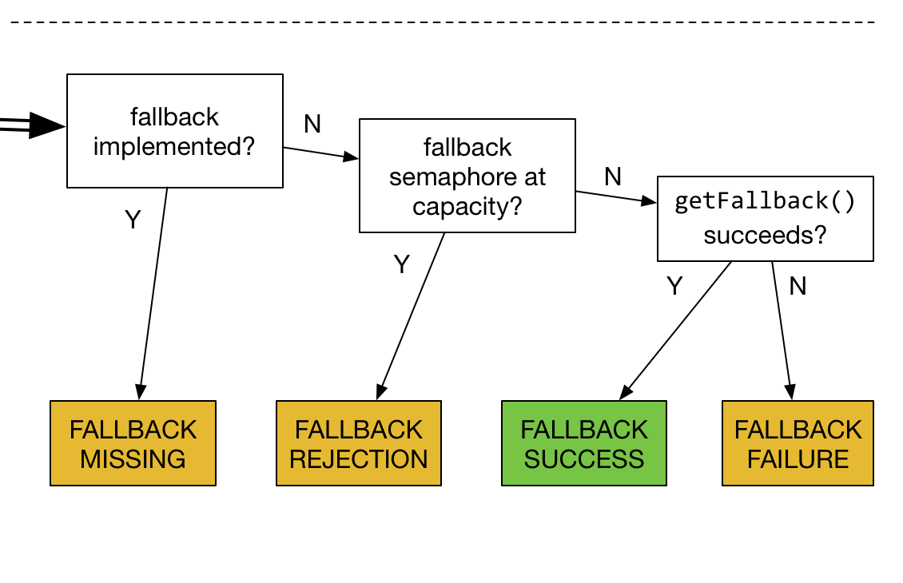
FALLBACK MISSING

Slide 114
FALLBACK MISSING

Slide 115
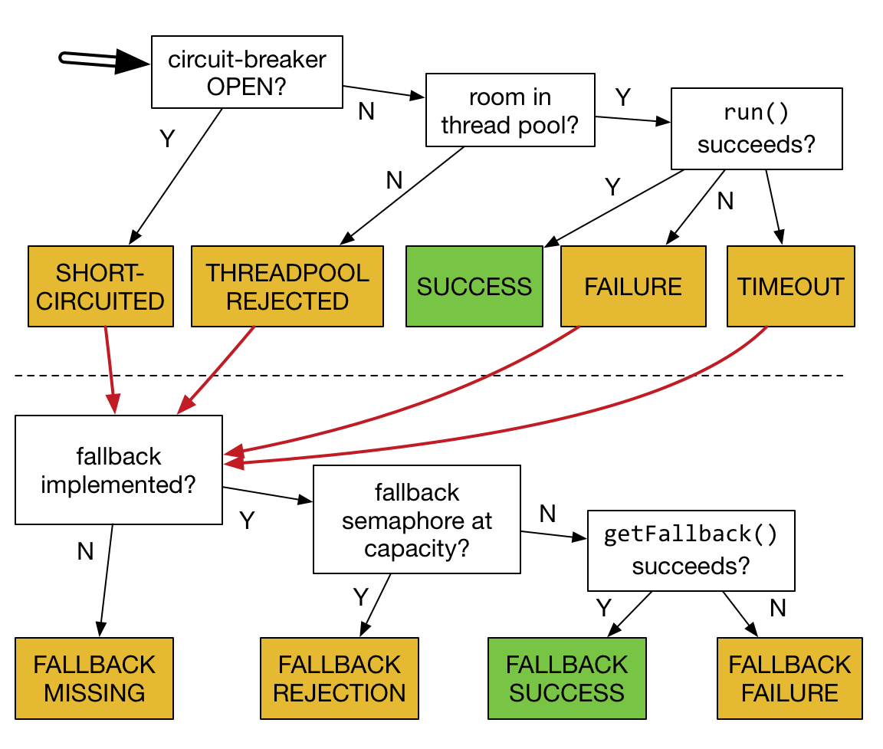

Slide 116
Hystrix as a building block
Now we have bounded latency and concurrency, along with a consistent fallback mechanism

Slide 117
Hystrix as a building block
Now we have bounded latency and concurrency, along with a consistent fallback mechanism
In practice within the Netflix API, we have:
~250 commands
~90 thread pools
10s of billions of command executions / day

Slide 118
Goals of this talk
Philosophical Motivation
Why are distributed systems hard?
Practical Motivation
Why do I keep getting paged?
Solving those problems with Hystrix
How does it work?
How do I use it in my system?
How should a system behave if I use Hystrix?
What? Netflix was down for me – what happened there?

Slide 119
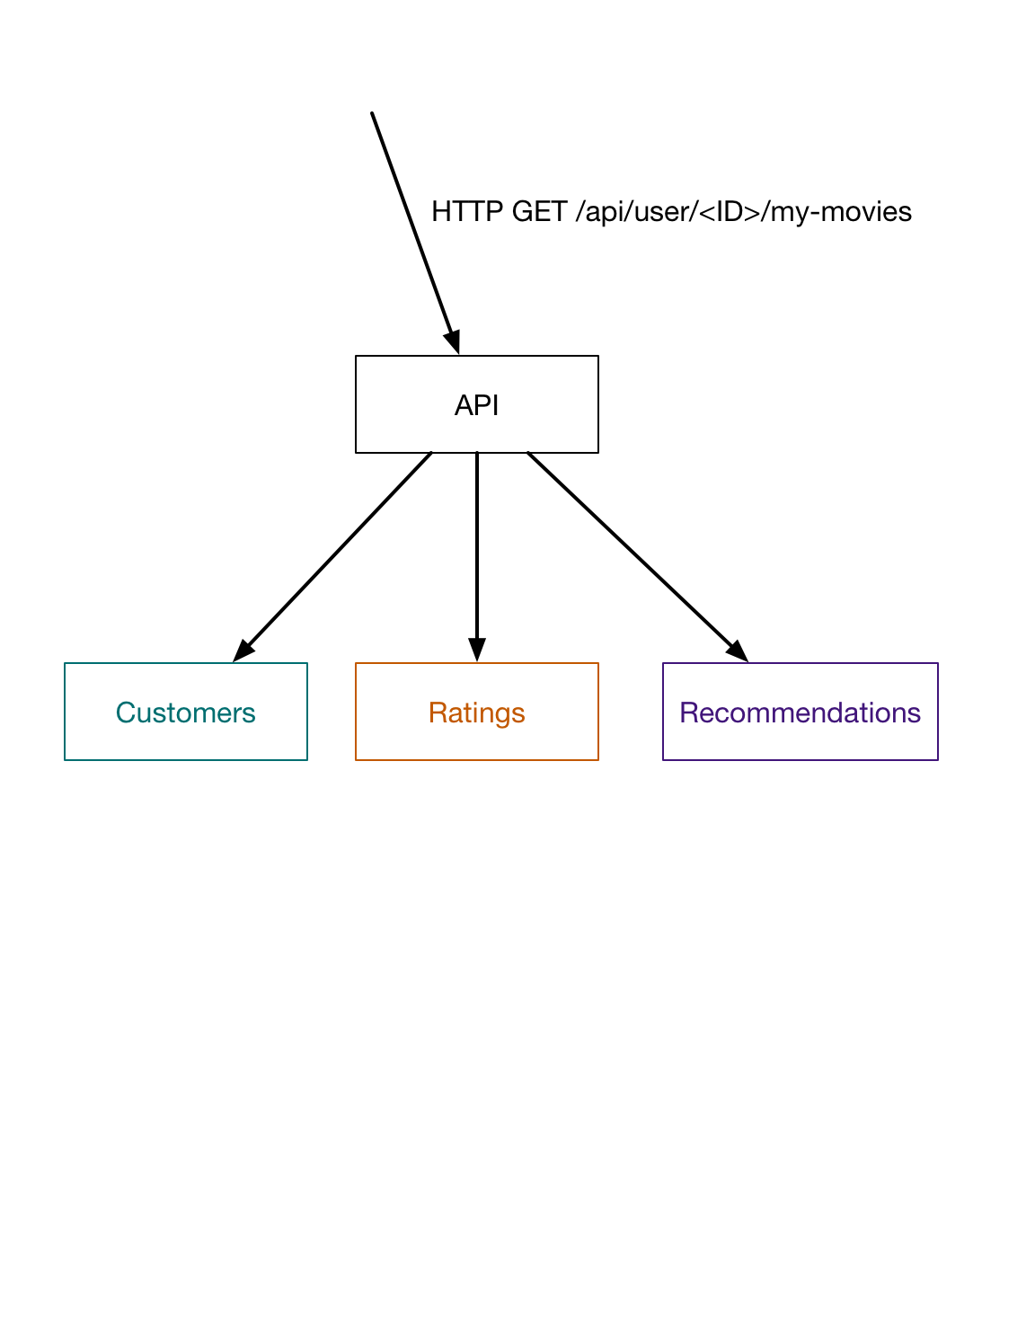
Example

Slide 120
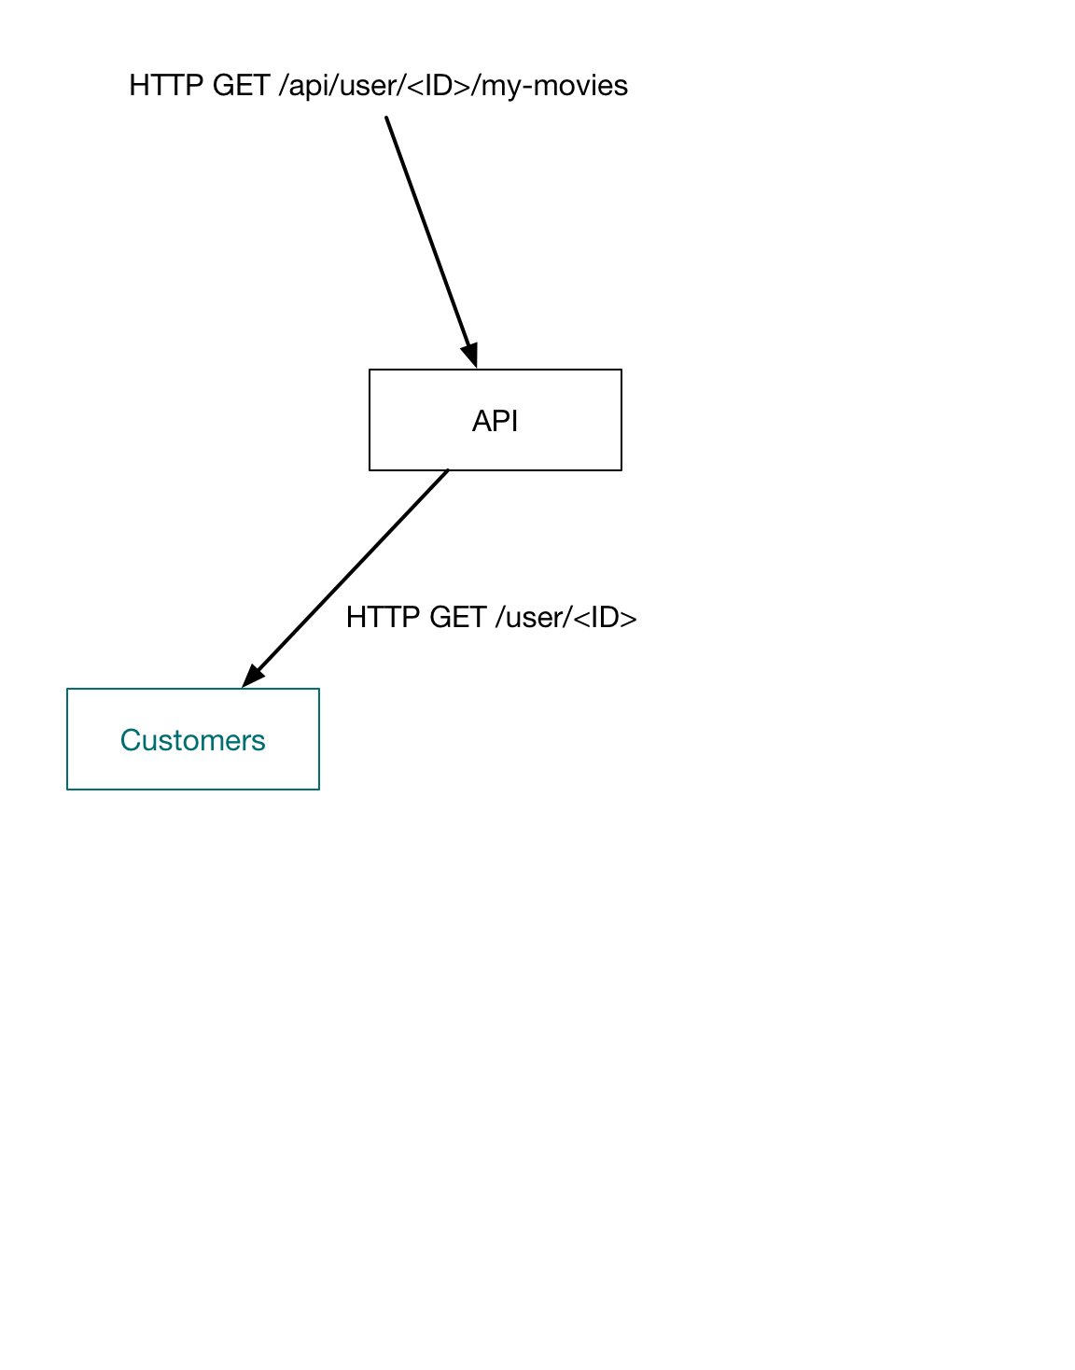
CustomerCommand
Takes id as arg
Makes HTTP call to service
Uses anonymous user as fallback
Customer has no personalization

Slide 121
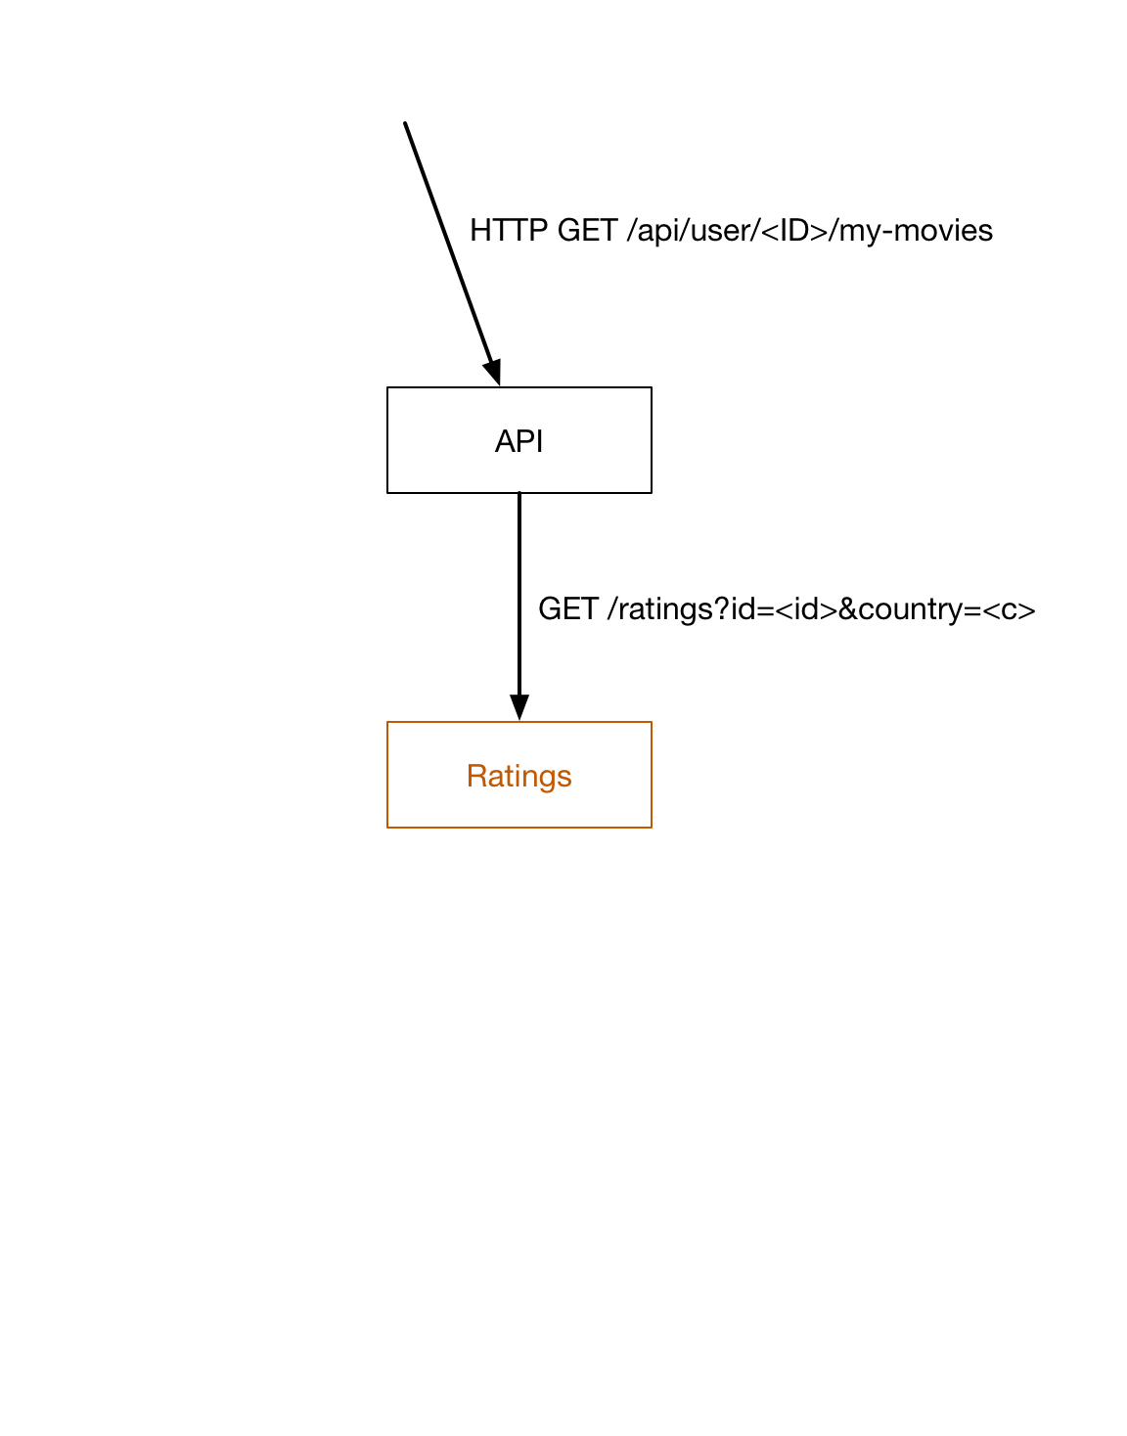
RatingsCommand
Takes Customer as argument
Makes HTTP call to service
Uses empty list for fallback
Customer has no ratings

Slide 122
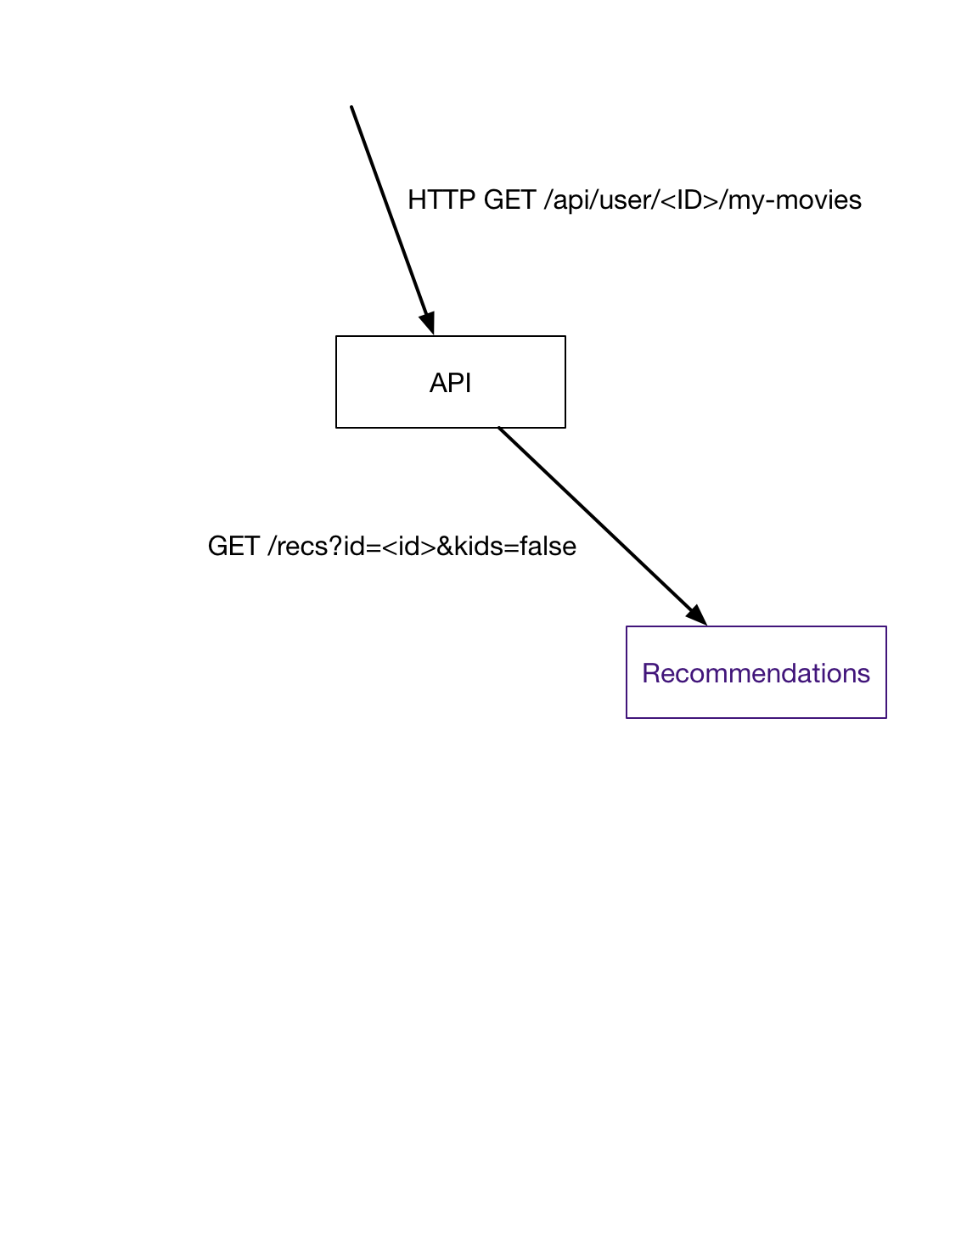
RecommendationsCommand
Takes Customer as argument
Makes HTTP call to service
Uses precomputed list for fallback
Customer gets unpersonalized
recommendations

Slide 123
Fallbacks in this example
Fallbacks vary in importance
Customer has no personalization
Customer gets unpersonalized recommendations
Customer has no ratings

Slide 125
HystrixCommand.execute()
Blocks application thread on Hystrix thread
Returns T

Slide 126
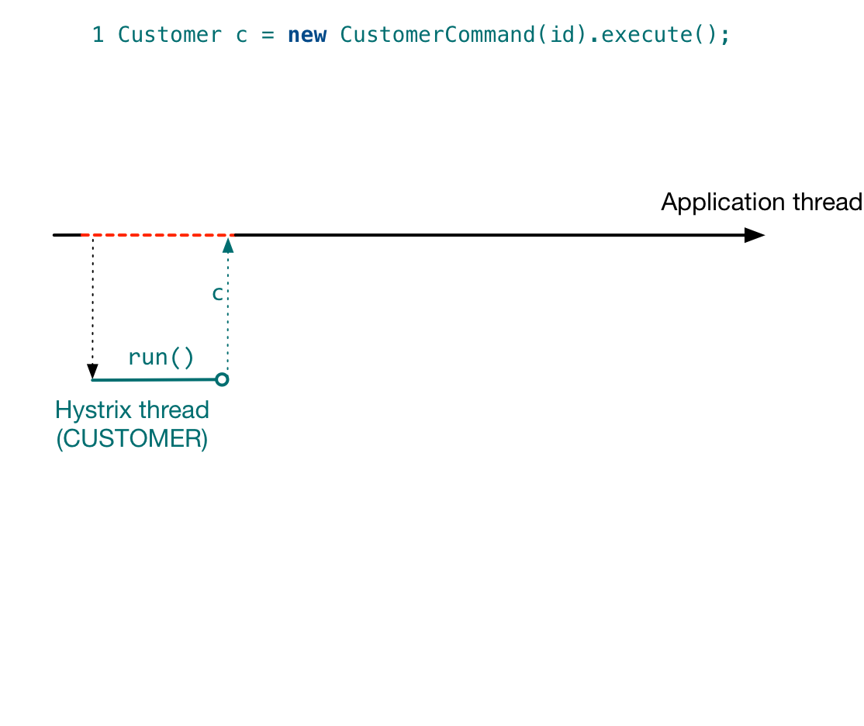

Slide 127
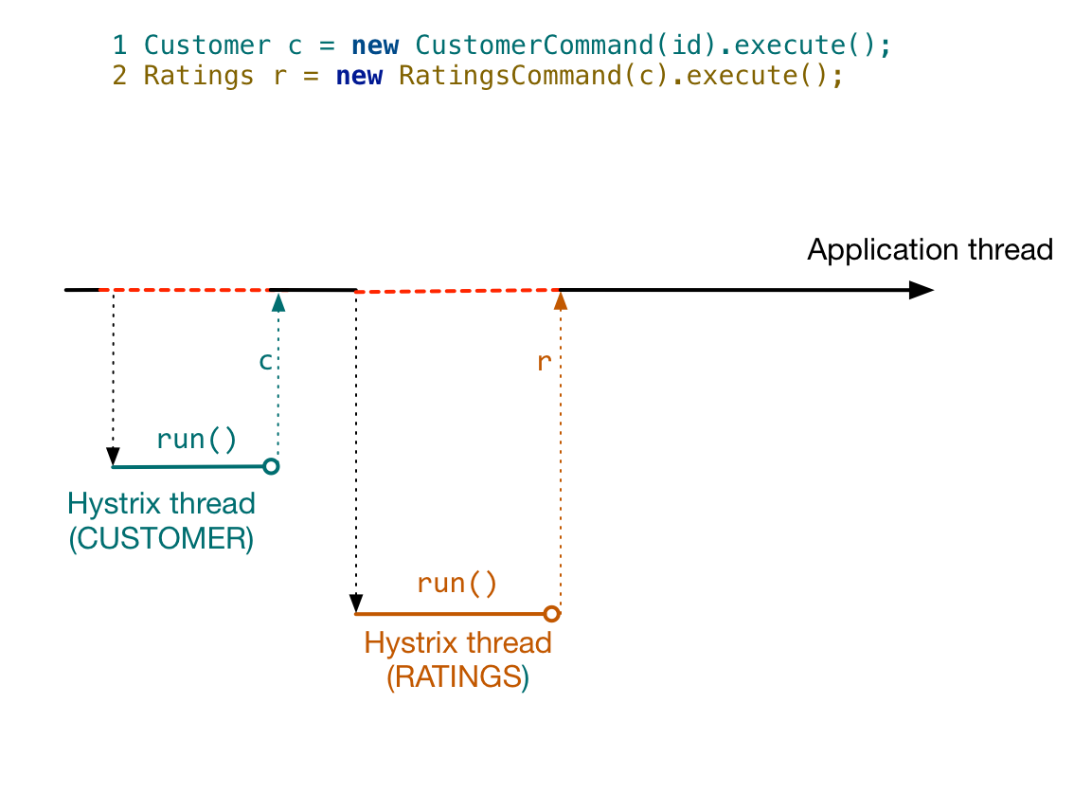

Slide 128
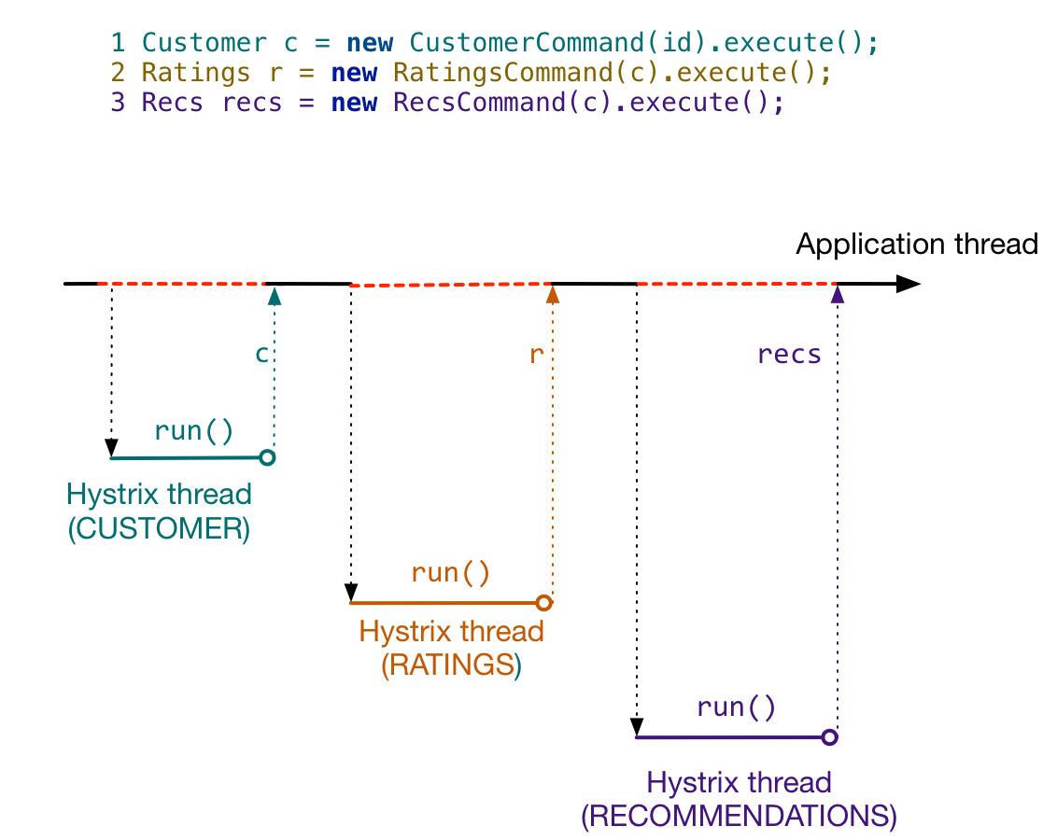

Slide 129
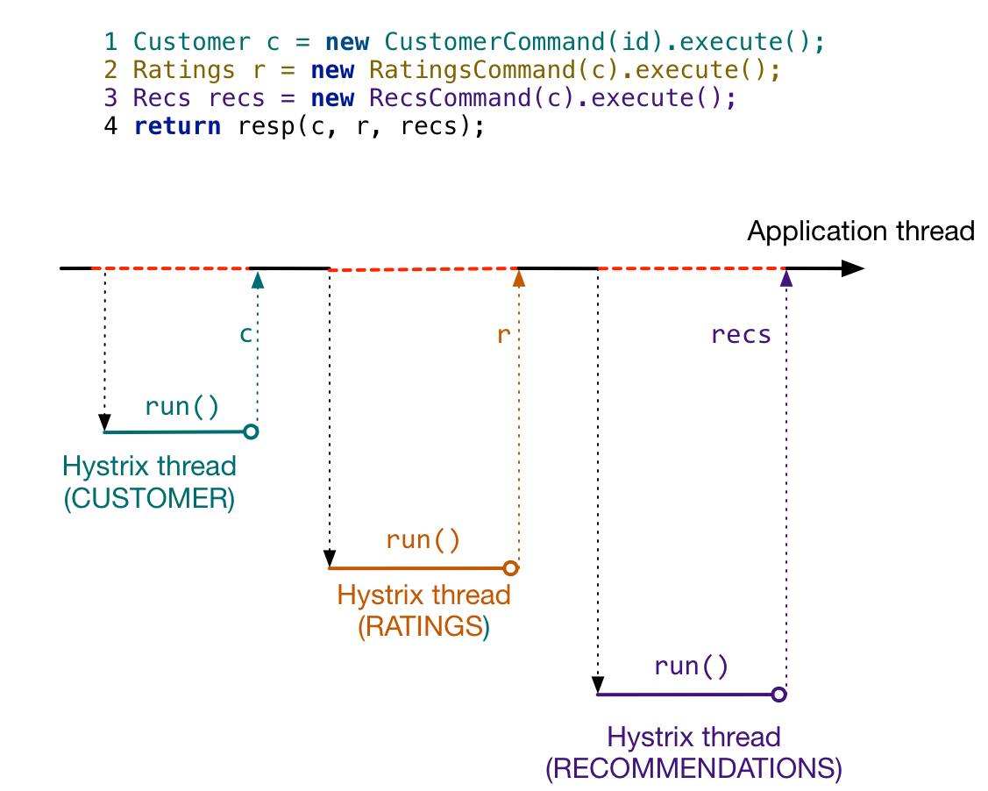

Slide 130
HystrixCommand.queue()
Does not block application thread
Application thread can launch multiple HystrixCommands
Returns java.util.concurrent.Future to application thread

Slide 131
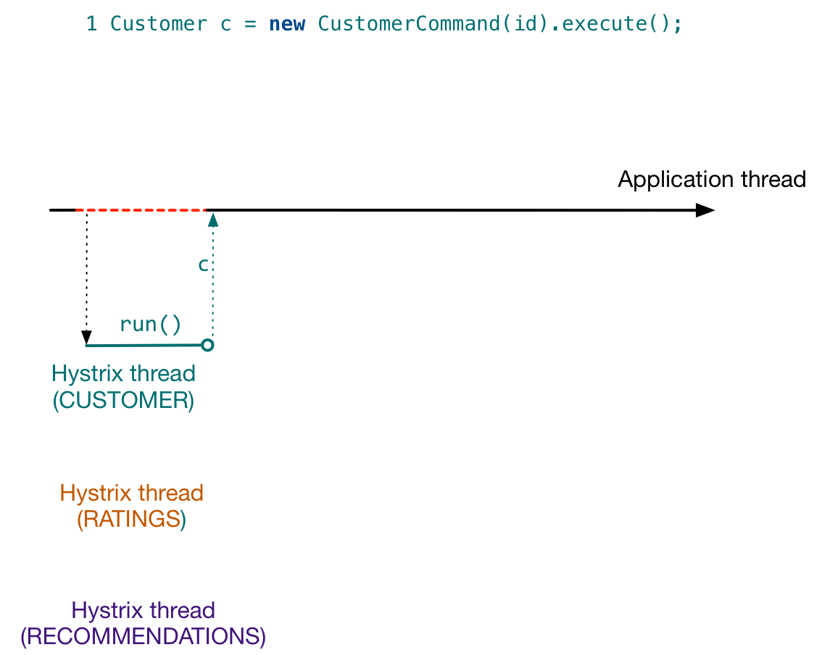

Slide 132
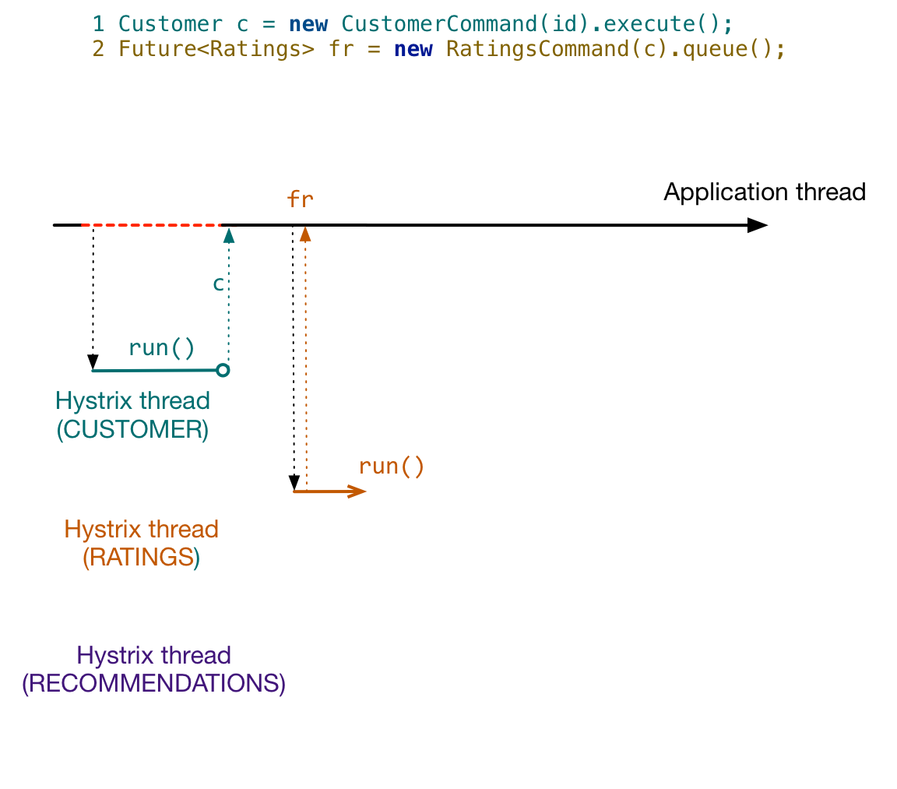

Slide 133
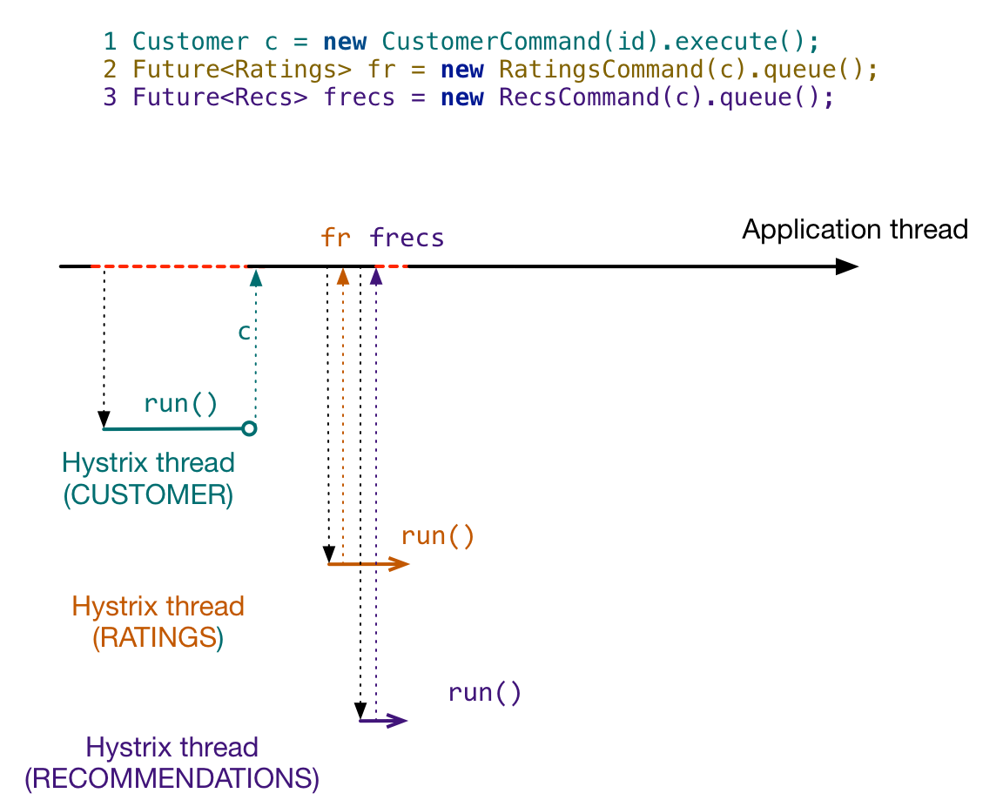

Slide 134
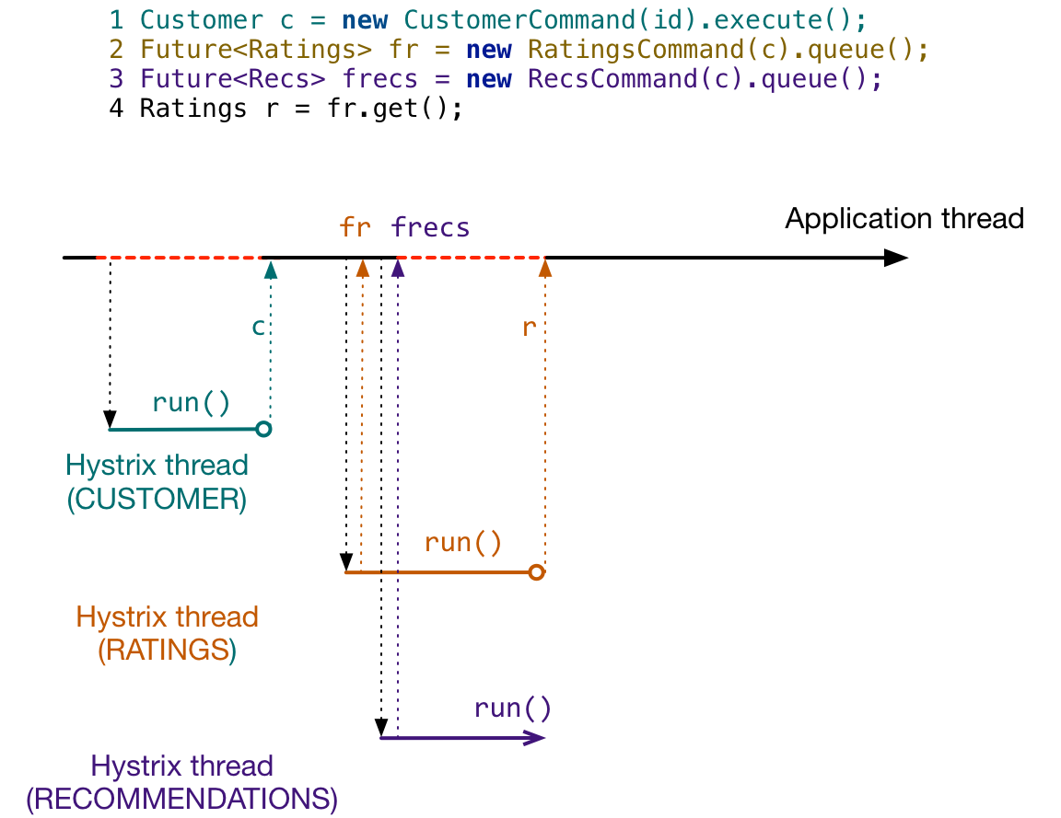

Slide 135


Slide 136


Slide 137

HystrixCommand.observe()
Does not block application thread
Returns rx.Observable to application thread
RxJava – reactive stream
reactivex.io

Slide 138


Slide 139


Slide 140


Slide 141


Slide 142


Slide 143


Slide 144


Slide 145


Slide 146


Slide 147


Slide 148
Goals of this talk
Philosophical Motivation
Why are distributed systems hard?
Practical Motivation
Why do I keep getting paged?
Solving those problems with Hystrix
How does it work?
How do I use it in my system?
How should a system behave if I use Hystrix?
What? Netflix was down for me – what happened there?

Slide 149
Hystrix Metrics
Hystrix provides a nice semantic layer to model
Abstracts details of I/O mechanism
HTTP?
UDP?
Postgres?
Cassandra?
Memcached?
…

Slide 150
Hystrix Metrics
Hystrix provides a nice semantic layer to model
Abstracts details of I/O mechanism
Can capture event counts and event latencies

Slide 151

Hystrix Metrics
Can be aggregated for historical time-series
hystrix-servo-metrics-publisher
Source: http://techblog.netflix.com/2014/12/introducing-atlas-netflixs-primary.html

Slide 152

Hystrix Metrics
Can be aggregated for historical time-series
hystrix-servo-metrics-publisher

Slide 153

Hystrix Metrics
Can be streamed off-box
hystrix-metrics-event-stream

Slide 154

Hystrix Metrics
Stream can be consumed by UI
Hystrix-dashboard

Slide 155
Hystrix metrics
Can be grouped by request
hystrix-core:HystrixRequestLog

Slide 156
Hystrix metrics
<DEMO>

Slide 157
Taking Action on Hystrix Metrics
Circuit Breaker opens/closes

Slide 158

Taking Action on Hystrix Metrics
Circuit Breaker opens/closes
Alert/Page on Error %

Slide 159
Taking Action on Hystrix Metrics
Circuit Breaker opens/closes
Alert/Page on Error %
Alert/Page on Latency

Slide 160

Taking Action on Hystrix Metrics
Circuit Breaker opens/closes
Alert/Page on Error %
Alert/Page on Latency
Use in canary analysis

Slide 161

How the system should behave
~100 RPS Success
~0 RPS Fallback

Slide 162

How the system should behave
~90 RPS Success
~10 RPS Fallback

Slide 163

How the system should behave
~5 RPS Success
~95 RPS Fallback

Slide 164

How the system should behave
~100 RPS Success
~0 RPS Fallback

Slide 165

How the system should behave
What happens if mean latency goes from 10ms -> 30ms?
Before Latency

Slide 166

How the system should behave
What happens if mean latency goes from 10ms -> 30ms?
Before Latency
After Latency

Slide 167
How the system should behave
What happens if mean latency goes from 10ms -> 30ms?
Increased timeouts
Before Latency
After Latency

Slide 168
How the system should behave
What happens if mean latency goes from 10ms -> 30ms at 100 RPS?

Slide 169

How the system should behave
What happens if mean latency goes from 10ms -> 30ms at 100 RPS?
By Little’s Law, mean utilization: 1 -> 3
Before Thread Pool
Utilization
->

Slide 170

How the system should behave
What happens if mean latency goes from 10ms -> 30ms at 100 RPS?
By Little’s Law, mean utilization: 1 -> 3
Before Thread Pool
Utilization
After Thread Pool
Utilization
->

Slide 171
How the system should behave
What happens if mean latency goes from 10ms -> 30ms at 100 RPS?
By Little’s Law, mean utilization: 1 -> 3
Increased thread pool rejections
Before Thread Pool
Utilization
After Thread Pool
Utilization
->

Slide 172

How the system should behave
~84 RPS Success
~16 RPS Fallback

Slide 173

How the system should behave
~48 RPS Success
~52 RPS Fallback

Slide 174
Lessons learned
Everything we measure has a distribution (once you add time)
Queuing theory can teach us a lot

Slide 175
Lessons learned
Everything we measure has a distribution (once you add time)
Queuing theory can teach us a lot
Errors are more frequent, but latency is more consequential

Slide 176
Lessons learned
Everything we measure has a distribution (once you add time)
Queuing theory can teach us a lot
Errors are more frequent, but latency is more consequential
100% success rates are not what you want!

Slide 177
Lessons learned
Everything we measure has a distribution (once you add time)
Queuing theory can teach us a lot
Errors are more frequent, but latency is more consequential
100% success rates are not what you want!
Don’t know if your fallbacks work
You have outliers, and they’re not being failed

Slide 178
Lessons learned
Everything we measure has a distribution (once you add time)
Queueing theory can teach us a lot
Errors are more frequent, but latency is more consequential
100% success rates are not what you want!
Don’t know if your fallbacks work
You have outliers, and they’re not being failed
Visualization (especially realtime) goes a long way

Slide 179
Goals of this talk
Philosophical Motivation
Why are distributed systems hard?
Practical Motivation
Why do I keep getting paged?
Solving those problems with Hystrix
How does it work?
How do I use it in my system?
How should a system behave if I use Hystrix?
What? Netflix was down for me – what happened there?

Slide 180
Areas Hystrix doesn’t cover
Traffic to the system
Functional bugs
Data issues
AWS
Service Discovery
Etc…

Slide 181
Hystrix doesn’t help if...
Your fallbacks fail

Slide 182
Hystrix doesn’t help if...
Your fallbacks fail
Upstream systems do not tolerate fallbacks

Slide 183
Hystrix doesn’t help if...
Your fallbacks fail
Upstream systems do not tolerate fallbacks
Resource bounds are too loose

Slide 184
Hystrix doesn’t help if...
Your fallbacks fail
Upstream systems do not tolerate fallbacks
Resource bounds are too loose
I/O calls don’t use Hystrix

Slide 185
Failing fallbacks
By definition, fallbacks are exercised less

Slide 186
Failing fallbacks
By definition, fallbacks are exercised less
Likely less tested

Slide 187
Failing fallbacks
By definition, fallbacks are exercised less
Likely less tested
If fallback fails, then you have cascaded failure

Slide 188
Unusable fallbacks
Even if fallback succeeds, upstream systems/UIs need to handle them

Slide 189
Unusable fallbacks
Even if fallback succeeds, upstream systems/UIs need to handle them
What happens when UI receives anonymous customer?

Slide 190
Unusable fallbacks
Even if fallback succeeds, upstream systems/UIs need to handle them
What happens when UI receives anonymous customer?
Need integration tests that expect fallback data

Slide 191

Unusable fallbacks
Even if fallback succeeds, upstream systems/UIs need to handle them
What happens when UI receives anonymous customer?

Slide 192
Loose Resource Bounding
“Kids, get ready for school!”

Slide 193
Loose Resource Bounding
“Kids, get ready for school!”
“You’ve got 8 hours to get ready”

Slide 194
Loose Resource Bounding
“Kids, get ready for school!”
“You’ve got 8 hours to get ready”
Speed limit is 1000mph

Slide 195

Loose Resource Bounding

Slide 196

Loose Resource Bounding

Slide 197
Unwrapped I/O calls
Any place where user traffic triggers I/O is dangerous

Slide 198
Unwrapped I/O calls
Any place where user traffic triggers I/O is dangerous
Hystrix-network-auditor-agent finds all stack traces that:
Are on Tomcat thread
Do Network work
Don’t use Hystrix

Slide 199
How to Prove our Resilience
“Trust, but verify”

Slide 200
How to Prove our Resilience
Get lucky and have a real outage

Slide 201
How to Prove our Resilience
Get lucky and have a real outage
Hopefully our system reacts the way we expect

Slide 202
How to Prove our Resilience
Get lucky and have a real outage
Hopefully our system reacts the way we expect
Cause the outage we want to protect against

Slide 203

How to Prove our Resilience
Get lucky and have a real outage
Hopefully our system reacts the way we expect
Cause the outage we want to protect against

Slide 204

Failure Injection Testing

Slide 205
Failure Injection Testing
Inject failures at any layer
Hystrix is a good one

Slide 206
Failure Injection Testing
Inject failures at any layer
Hystrix is a good one
Scope (region / % traffic / user / device)

Slide 207
Failure Injection Testing
Inject failures at any layer
Hystrix is a good one
Scope (region / % traffic / user / device)
Scenario (fail?, add latency?)

Slide 208
Failure Injection Testing
Inject error and observe fallback successes

Slide 209
Failure Injection Testing
Inject error and observe fallback successes
Inject error and observe device handling fallbacks

Slide 210
Failure Injection Testing
Inject error and observe fallback successes
Inject error and observe device handling fallbacks
Inject latency and observe thread-pool rejections and timeouts

Slide 211
Failure Injection Testing
Inject error and observe fallback successes
Inject error and observe device handling fallbacks
Inject latency and observe thread-pool rejections and timeouts
We have an off-switch in case this goes poorly!

Slide 212
FIT in Action
<DEMO>

Slide 213
Operational Summary
Downstream transient errors cause fallbacks and a degraded but not broken customer experience

Slide 214
Operational Summary
Downstream transient errors cause fallbacks and a degraded but not broken customer experience
Fallbacks go away once errors subside

Slide 215
Operational Summary
Downstream transient errors cause fallbacks and a degraded but not broken customer experience
Fallbacks go away once errors subside
Downstream latency increases load/latency, but not to a dangerous level

Slide 216
Operational Summary
Downstream transient errors cause fallbacks and a degraded but not broken customer experience
Fallbacks go away once errors subside
Downstream latency increases load/latency, but not to a dangerous level
We have near realtime visibility into our system and all of our downstream systems

Slide 217
References
Sandvine internet usage report
Fallacies of Distributed Computing
Little’s Law
Release It!
Netflix Techblog: Atlas
Netflix Techblog: FIT
Netflix Techblog: Hystrix
Netflix Techblog: How API became reactive
Spinnaker OSS
Antifragile

Slide 218
Coordinates
github.com/Netflix/Hystrix
@HystrixOSS
@NetflixOSS
@mattrjacobs
mjacobs@netflix.com
jobs.netflix.com (We’re hiring!)

Slide 219
Bonus: Hystrix Config

Slide 220
Bonus: Hystrix 1.5 Metrics

Slide 221
Bonus: Horror Stories

